Slide 2
What am I reading?
You are reading a Supplementary Analysis prepared by the Canadian Index of Wellbeing (CIW), using the Nova Scotia Quality of Life Survey results.
These slides share information you’d find in a report – but in a slide format – so, the notes below each slide are detailed.
This work is an example of what can be explored beyond the eight domains when further analysis is undertaken.
In March 2020 Engage Nova Scotia released Summary Results for all 230 questions - for ten regions across the province and the province overall.

Slide 3
Engage Nova Scotia and the NS Quality of Life Initiative
Engage Nova Scotia is a non-profit whose focus is a vibrant, inclusive and resilient province. We have been driving the Nova Scotia Quality of Life Initiative since 2017.
Our primary research partner in the Nova Scotia Quality of Life Initiative is the Canadian Index of Wellbeing (CIW) at the University of Waterloo.
The NS Quality of Life Survey was undertaken in Spring 2019, and so, prior to the COVID-19 pandemic. It asked 230 questions across eight domains of wellbeing. Almost 13,000 Nova Scotians responded.

Slide 4
What will I learn?
These graphs show:
high-level information about demographic groups that caught the attention of the CIW;
insights about the eight domains;
new analysis related to six areas of focus:
Social isolation; Sense of community; Feelings of trust; Experiences of discrimination; Poverty; and, Health.
To access raw data, ask for further analysis, or explore the intersectional variables available, visit our Research and Analysis page online.
You can read about the survey methods, including sample size, sampling strategy, weighting, and the demographic profile of respondents in the full summary results.

Slide 5
A Closer Look:
The Nova Scotia Quality of Life Survey
based on the CIW Community Wellbeing Survey
A Report of the Canadian Index of Wellbeing
Prepared for:
Engage Nova Scotia
Fall 2020 (Updated)
Notes:
A Closer Look: The Nova Scotia Quality of Life Survey
When referring to this report, please use this citation:
Smale, B., & Gao, M. (2020). A Closer Look: The Nova Scotia Quality of Life Survey based on the CIW Community Wellbeing Survey. A report prepared for Engage Nova Scotia. Waterloo, ON: Canadian Index of Wellbeing and University of Waterloo.
‹#›
For more information about the CIW, visit www.ciw.ca

Slide 6
2019 Nova Scotia Quality of Life Survey
Notes:
‹#›

Slide 7
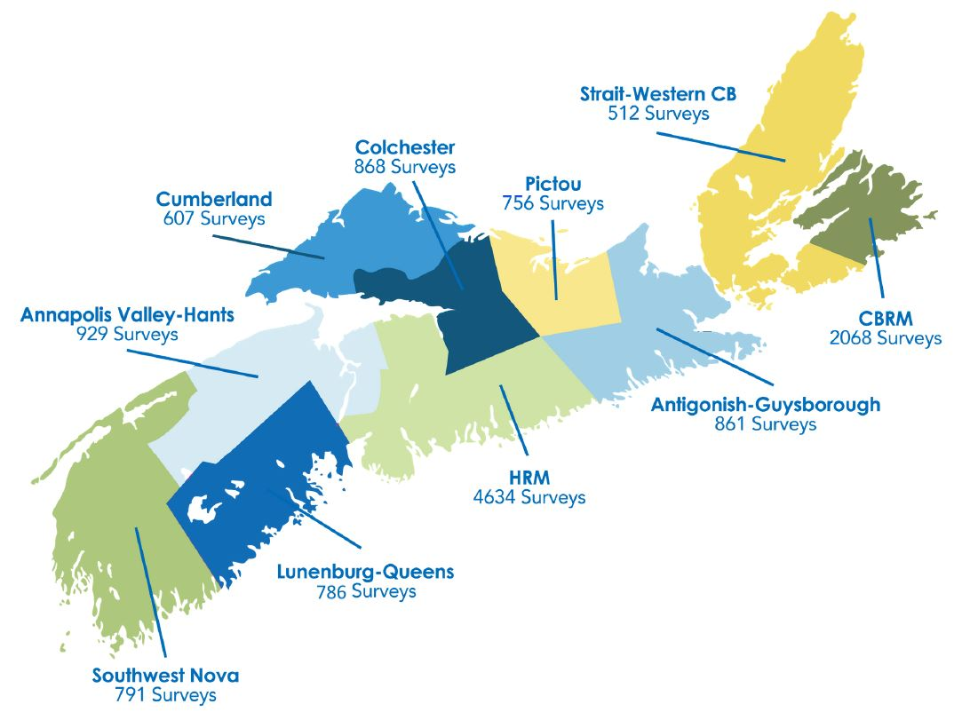
Geographic distribution of Nova Scotia sample
Notes:
‹#›

Slide 8
Demographics and Quality of Life
Notes:
Demographics and Quality of Life
Recognizing the unique socio-demographic profile of a region is an important first step in understanding the needs and circumstances of its residents. How many people live here? Are the residents generally younger or older? What do their families look like? How diverse is the population? Answers to these questions allow us to make more informed decisions about the types of programs and services that will best contribute to the quality of life of Nova Scotians.
In this section, we take a look at selected sub-groups within the population that are more vulnerable to inequities in different aspects of their quality of life.
‹#›

Slide 9
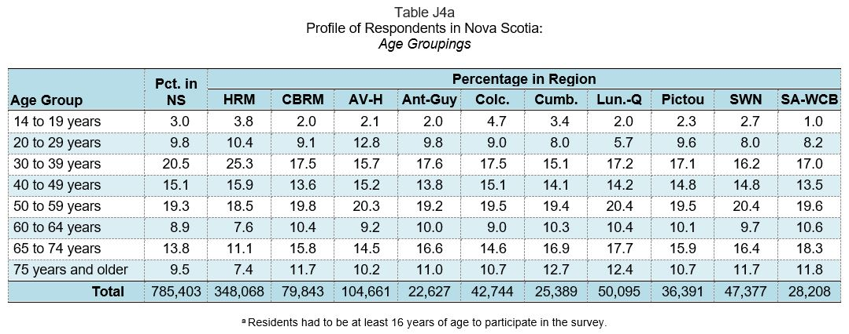
Older adults and quality of life
Older adults: Residents aged 65 to 74 years and those 75 years and older
Note: Older adults represent 23.3% of Nova Scotia residents
Notes:
Selected characteristics of older adults (65 years and older)
Selected demographics
More than half (54.6%) are women.
About two-thirds (65.2%) are married and almost one in five (18.2%) are widowed.
Just under half (48.3%) have a college diploma, university, or graduate degree.
Higher percentages of older adults live in Lunenburg-Queens (30.1%), Strait Area-West Cape Breton (30.1%), Cumberland (29.6%), and South West Nova (28.1%). Comparatively fewer older adults live in Halifax RM (18.5%).
Income and Work
Majority of older adults (83.9%) are retired.
About one in five (19.0%) have an annual household income less than $30,000, and 15.4% have an annual household income of $100,000 or higher.
Housing
Majority of older adults (84.5%) spend less than 30% of their monthly income on housing; many fewer (13.3%) spend 30% to 50% of their monthly income on housing; and very few (2.3%) spend more than 50% of their monthly income on housing.
Health
Almost one in three older adults (30.0%) live with a disability (physical or mental) or a chronic illness that limits their activity, a higher percentage than that of the overall general population (26.0%).
‹#›

Slide 10
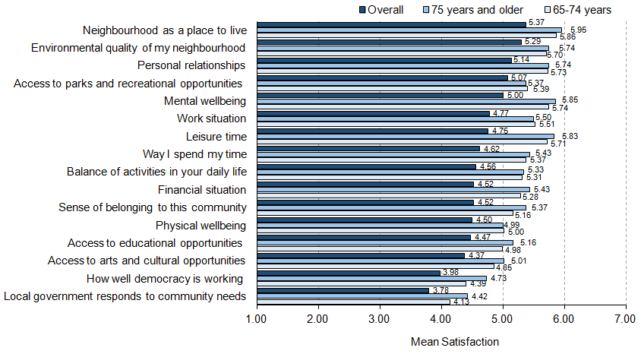
Older adults and quality of life
Notes:
Older adults and quality of life
“How do older adults and the general population compare on satisfaction with aspects of quality of life?”
Older adults are more satisfied with all aspects of quality of life compared to the general population.
Older adults who are 75 years and older have higher satisfaction with most of aspects of quality of life compared to those who are 65 to 74 years of age, except on physical wellbeing, work situation, and access to parks and recreation opportunities.
Older adults 65 years and older are significantly more satisfied than the general population with their leisure time and their financial situation, and much more satisfied with their mental wellbeing, the way they spend their time, and the balance of activities in their daily lives.
Note: Average scores are based on a 7-point scale, where 1=extremely dissatisfied and 7=extremely satisfied.
‹#›

Slide 11
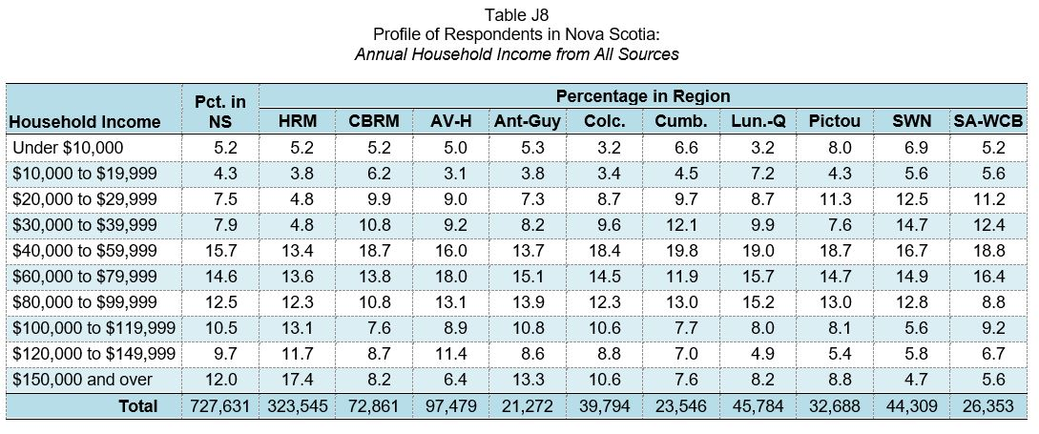
Lower income residents and quality of life
Lower income: Total annual household income before taxes from all sources was $30,000 or less
Note: Residents living with lower incomes represent 17.0% of Nova Scotians
Notes:
Selected characteristics of residents in the lower income group
Selected demographics
Almost six in 10 (57.6%) are women.
Just under half (47.9%) are under 40 years of age.
Just under half (45.3%) are single, never married.
Almost one in 10 (9.5%) were not born in Canada.
Almost half (48.6%) report their highest level of education is high school or elementary school while one in six (17.6%) have an undergraduate or Master’s degree.
Work
One in five (21.4%) do not work (i.e., are unemployed, or on leave from work).
Housing
Almost half (48.1%) spend less than 30% of their monthly income on housing and about one-third (34.9%) spend 30% to 50% of their monthly income on housing. About one in six (17.0%) spend more than 50% of their monthly income on housing.
More than one-quarter (28.8%) live alone and almost one in five (19.0%) share accommodation with other adults.
Over one-third (37.1%) rent their current residence.
Health
Just under half (45.3%) live with a disability (physical or mental) or a chronic illness that limits their activity, which is a much higher percentage than that of the overall population (26.0%).
‹#›

Slide 12
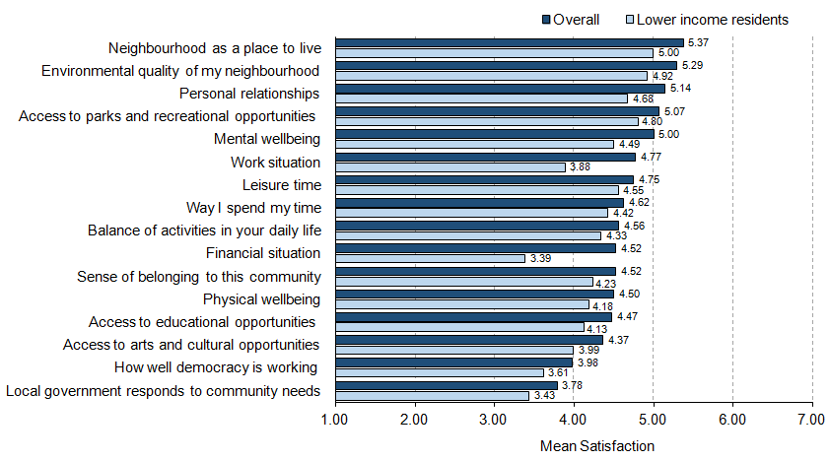
Lower income residents and quality of life
Notes:
Lower income and quality of life
“How do residents living with lower incomes and the general population compare on satisfaction with aspects of quality of life?”
Residents with lower incomes are less satisfied with all aspects of quality of life compared to the general population.
Residents with lower incomes are significantly less satisfied than the general population with their financial situation and their work situation, and much less satisfied with their mental wellbeing and their personal relationships.
Note: Average scores are based on a 7-point scale, where 1=extremely dissatisfied and 7=extremely satisfied.
‹#›

Slide 13
Single residents living alone and quality of life
Single, never married residents living alone:
Residents who are single, never married that living alone
Note: Residents who are single, never married, and living alone represent 5.3% of Nova Scotians
Notes:
Selected characteristics of single, never married residents living alone
Selected demographics
Over half (54.0%) are women.
Average age is between 47 and 48 years.
Average time living in Canada is about 46 years.
Average time they have been a resident of the community is 25 to 26 years.
Majority of singles living alone were born in Canada (90.5%).
Income and Work
Almost half (48.2%) are employed full-time.
Over one-third (36.7%) have an annual household income less than $30,000, which is more than twice the percentage of Nova Scotia’s overall population (17.0%).
Housing
Over half (52.3%) spend less than 30% of their monthly income on housing and over one-third (35.8%) spend 30% to 50% of their monthly income on housing. Over one in 10 (11.8%) spend more than 50% of their monthly income on housing.
Health
Over one-third (35.4%) live with a disability (physical or mental) or a chronic illness that limits their activity, which is almost 10% higher than that of the general population (26.0%).
‹#›

Slide 14
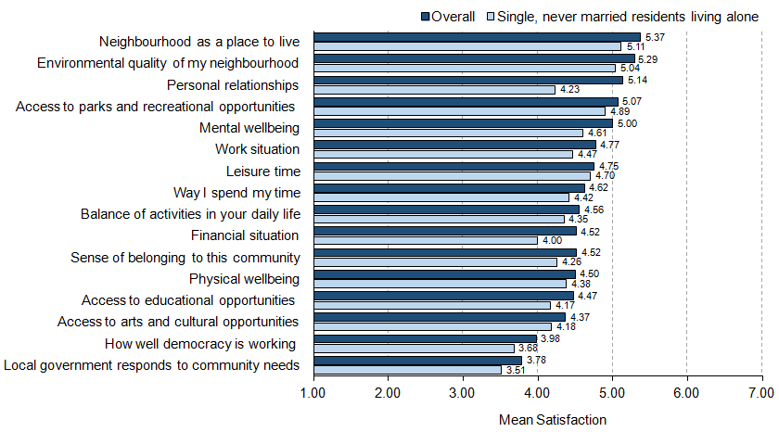
Single, never married residents and quality of life
Notes:
Single, never married residents living alone and quality of life
“How do single, never married residents living alone and the general population compare on satisfaction with aspects of quality of life?”
Single, never married residents living alone are less satisfied with all aspects of quality of life compared to the general population.
Single, never married residents living alone are significantly less satisfied than the general population with their personal relationships, much less satisfied with their financial situation, and less satisfied with their mental wellbeing.
Note: Average scores are based on a 7-point scale, where 1=extremely dissatisfied and 7=extremely satisfied.
‹#›

Slide 15
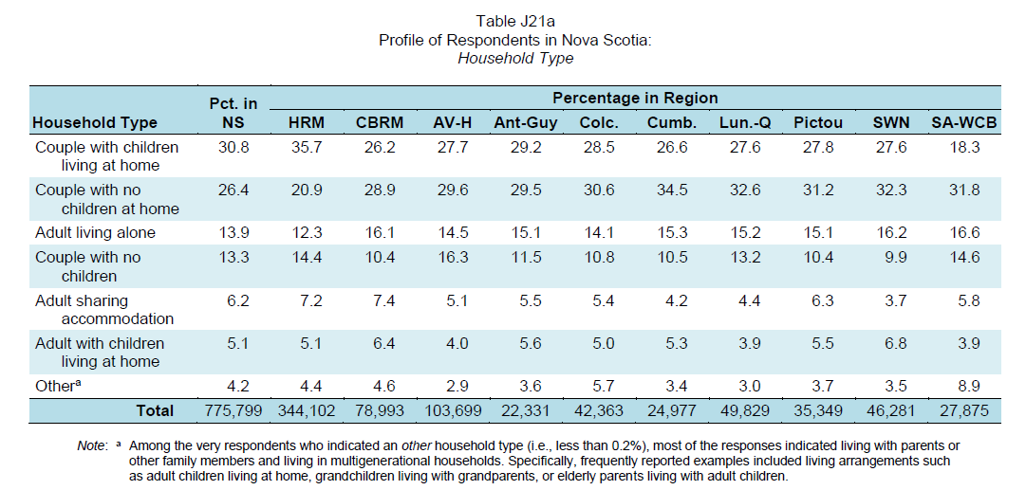
Single parents and quality of life
Single parents: Residents who are in households of one adult living with children at home
Notes:
Selected characteristics of single parents
Selected demographics
Almost three-quarters of single parents (72.8%) are women.
Over four in 10 (42.0%) are never married, about one-quarter (23.3%) are divorced, and one in six (16.6%) are separated.
Average age of single parents is about 43 years.
Over one-third (34.1%) have been a resident of the community less than 5 years.
Majority of single parents (97.1%) were born in Canada.
Income and Work
Under half (45.4%) are employed full-time.
Over one-third (36.3%) have an annual household income less than $30,000, which is more than twice the percentage than that of the Nova Scotia’s overall population (17.1%).
Housing
Almost two-thirds of single parents (64.7%) rent their current residence, which is five times higher than the provincial rate (12.9%).
Almost half (48.2%) spend less than 30% of their monthly income on housing and over one-third (37.9%) spend 30% to 50% of their monthly income on housing. About one in seven single parents (13.9%) spend more than 50% of their monthly income on housing.
Health
About one-third (32.4%) live with a disability (physical or mental) or a chronic illness that limits their activity, a higher percentage than that of the general population (26.0%).
‹#›

Slide 16
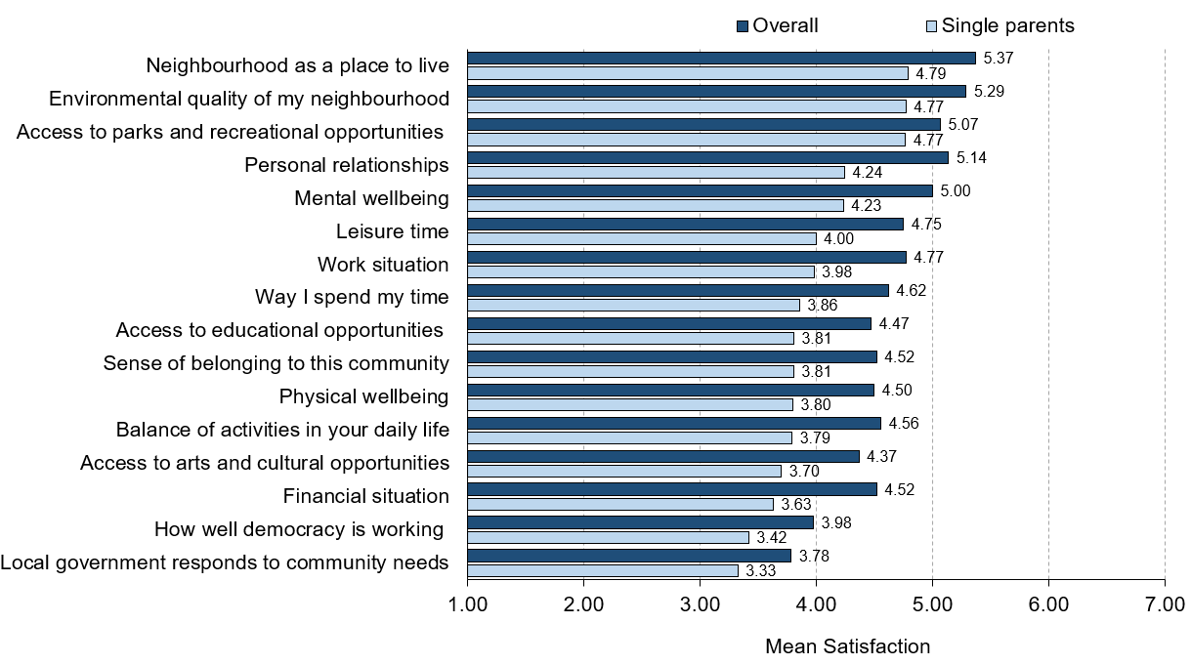
Single parents and quality of life
Notes:
Single parents and quality of life
“How do single parents and the general population compare on satisfaction with aspects of quality of life?”
Single parents are less satisfied with all aspects of quality of life compared to the general population.
In particular, single parents are significantly less satisfied than the general population with their personal relationships and their financial situation; are much less satisfied with their work situation, their mental wellbeing, the way they spend their time, and the balance of activities in their daily lives; and less satisfied with their sense of belonging to the community, their physical wellbeing, and their access to arts and cultural and to educational opportunities.
Note: Average scores are based on a 7-point scale, where 1 = extremely dissatisfied and 7 = extremely satisfied.
‹#›

Slide 17
Disability/chronic illness and quality of life
Living with a disability or chronic illness:
Residents who are living with a physical or mental disability or a chronic illness that limits their activity
Note: Residents who are living with a disability or chronic illness represent 26.0% of Nova Scotians
Notes:
Selected characteristics of residents living with a disability or chronic illness
Selected demographics
Average age is 51 years.
Over half (54.0%) are women.
Just under half (45.9%) have a college diploma, university, or graduate degree.
Approximately one in six (17.9%) are adults living alone.
Income and Work
Three in 10 (29.9%) have annual household incomes of less than $30,000.
Just over one-quarter (27.4%) are employed full-time.
Housing
Six in 10 (60.1%) spend less than 30% of their monthly income on housing and about one-third (31.9%) spend 30% to 50% of their monthly income on housing. Under one in 10 (8.0%) spend more than 50% of their monthly income on housing.
Health
Three to four in 10 individuals feel their participation in the community is limited by a physical disability (40.6%), by a chronic illness (38.7%), or by a mental health challenge (29.8%).
‹#›

Slide 18
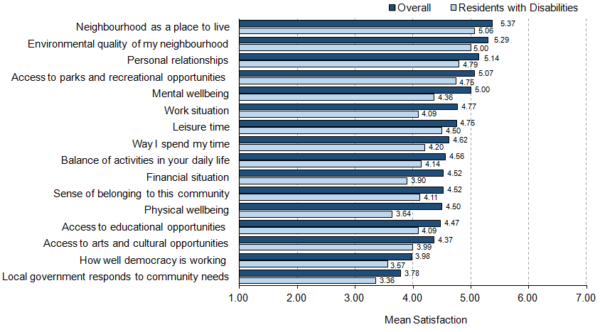
Disability/chronic illness and quality of life
Notes:
Residents living with a disability or chronic illness and quality of life
“How do residents with a disability or chronic illness and the general population compare on satisfaction with aspects of quality of life ?”
Residents living with a disability or chronic illness are less satisfied with all aspects of quality of life compared to the general population.
In particular, residents living with a disability or chronic illness are significantly less satisfied than the general population with their physical wellbeing, and much less satisfied with their work and financial situation, and their mental wellbeing.
Note: Average scores are based on a 7-point scale, where 1=extremely dissatisfied and 7=extremely satisfied.
‹#›

Slide 19
New residents and quality of life
New residents: Residents who have lived in their current community for 5 years or less
Residents who have lived in their current community for 5 years or less
Note: People who have lived in their current community for 5 years or less represent 25.5% of residents
Notes:
Selected characteristics of residents who have lived in their current community for 5 years or less.
Selected demographics
Over half (52.4%) are women.
About two-thirds (64.8%) are under 40 years of age.
Almost half (45.1%) are married and about one-quarter (23.5%) are single (never married).
Over one-third (34.2%) are couples with children living at home and one in five (20.2%) are couples with no children.
One in eight (12.5%) live alone and one in ten (9.9%) share accommodation with other adults.
Almost half (48.3%) have a university or graduate degree.
Income and Work
Over half (53.5%) are employed full-time.
Almost one-quarter (23.3%) report an annual household income of less than $30,000.
Housing
Almost half of new residents (49.3%) spend less than 30% of their monthly income on housing and four in 10 (41.5%) spend 30% to 50% of their monthly income on housing. Just under one in 10 (9.2%) spend more than 50% of their monthly income on housing.
Just under one-third (30.2%) of new residents are renting their current residence.
Health
One-quarter of new residents (25.6%) live with a disability (physical or mental) or a chronic illness that limits their activity, which is the same as the percentage in the general population (26.0%).
‹#›

Slide 20
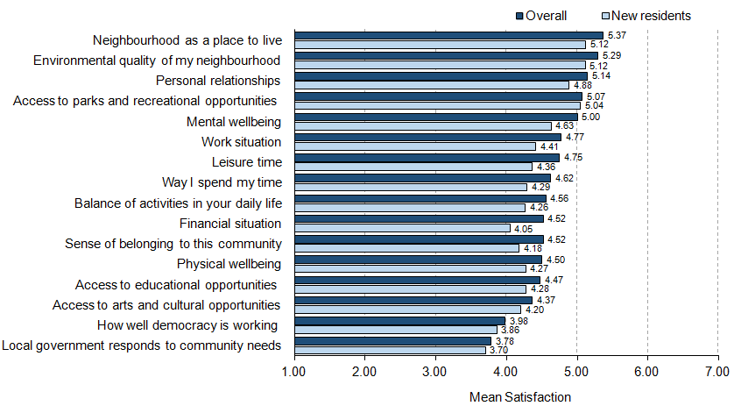
New residents and quality of life
Notes:
New residents and quality of life
“How do new residents and the general population compare on satisfaction with aspects of quality of life?”
New residents are less satisfied with all aspects of quality of life compared to the general population of Nova Scotia.
Specifically, new residents are much less satisfied than the general population with their financial situation, and less satisfied their leisure, their mental wellbeing, and their work situation.
Note: Average scores are based on a 7-point scale, where 1=extremely dissatisfied and 7=extremely satisfied.
‹#›

Slide 21
Selected Characteristics within CIW Domains of Quality of Life
Notes:
Selected Characteristics within CIW Domains of Quality of Life
In this section, we examine the relationship between selected characteristics associated with the CIW’s eight domains of quality of life and key demographic indicators – income, age, the region within which Nova Scotians live, and their living arrangements. The results are illustrative of the circumstances within each domain that are associated with higher and lower levels of quality of life for Nova Scotians.
‹#›

Slide 22
Community Vitality
Notes:
Community Vitality
Vital communities are those that have strong, active, and inclusive relationships among people, private, public, and non-governmental organizations that foster individual and collective wellbeing.
Vital communities are able to cultivate and marshal rich and diverse relationships in order to create, adapt, and thrive in the changing world. They do so by focusing on social relationships and support, including community safety and social engagement, and on social norms and values, including feelings towards others and residents’ sense of belonging to their communities.
In this section on Community Vitality, we look at social connections, including close relatives and close friends that people feel at ease with, can talk to, or call for help; and neighbours from whom people feel they can ask a favour.
‹#›

Slide 23
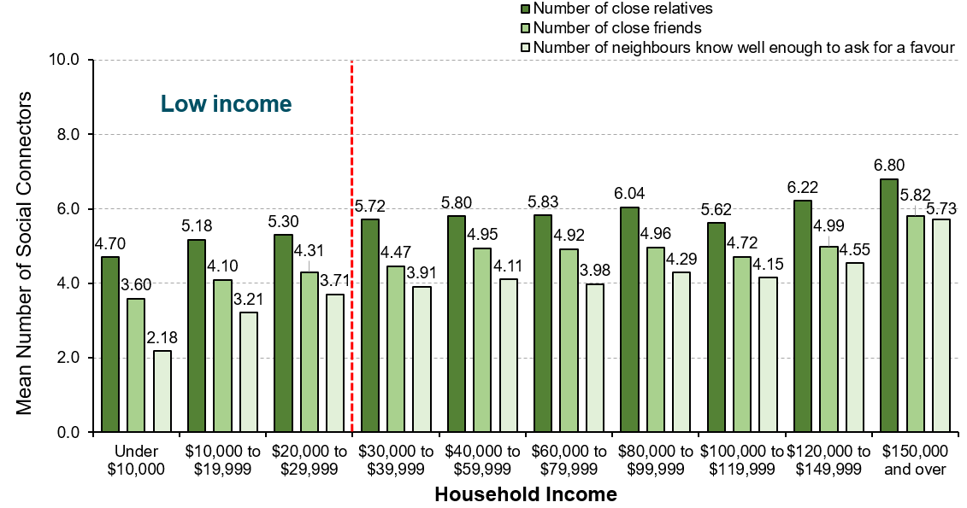
Numbers of social connections by income
Notes:
Community Vitality
“How many close social connections do residents with different household incomes report?”
There is a clear relationship between income and numbers of close social connections that Nova Scotians report. As annual household incomes increase, so do the average numbers of close relatives, of close friends, and of neighbours residents know well enough to ask for a favour.
‹#›

Slide 24
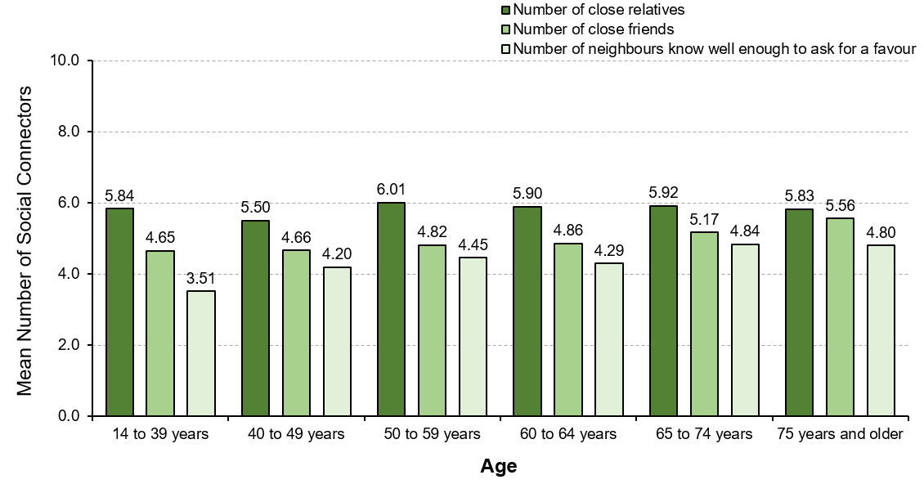
Numbers of social connections by age
Notes:
Community Vitality
“How many close social connections do residents of different ages report?”
There are small variations on reported numbers of close relatives among residents in different age groups.
Age appears to be related to the average numbers of close friends and of neighbours residents know well enough to ask for a favour. As people age, the numbers of close friends and neighbours they have increase. Age is not strongly associated with the number of close relatives reported.
‹#›

Slide 25
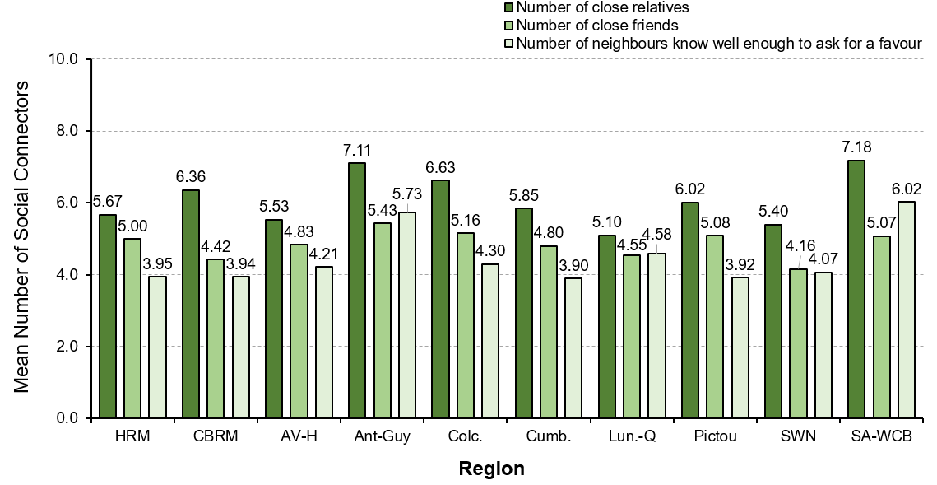
Number of social connections by region
Notes:
Community Vitality
“How many close social connections do residents residing in different regions report?”
Residents living in Antigonish-Guysborough, Strait Area-West Cape Breton, and Colchester report having more close relatives, whereas residents living in Lunenburg-Queens report the lowest number of close relatives.
More so than residents of other regions, residents living in Antigonish-Guysborough report having more close friends. In contrast, people residing in South West Nova report having the fewest close friends in their community.
Residents living in Strait Area-West Cape Breton have more neighbours that they know well enough to ask for a favour. In contrast, people living in Cumberland report the fewest neighbours that they can count on to do them a favour.
‹#›

Slide 26
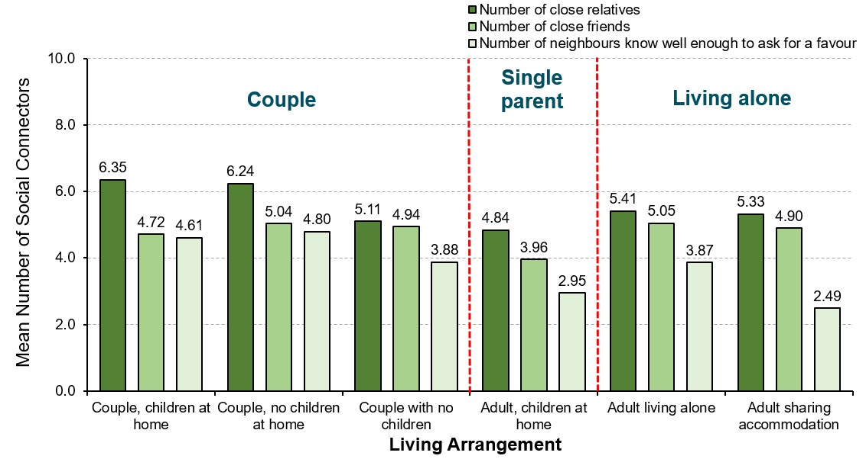
Number of social connections by living arrangement
Notes:
Community Vitality
“How many close social connections do residents with different living arrangements report?”
Couples, whether living with children at home or with no children at home, report more close relatives than people with other living arrangements.
Single parents report having the fewest close friends with whom they feel at ease, can talk to about what is on their mind, or call on for help.
Couples, whether living with children at home or with no children at home, report having more neighbours that they know well enough to ask for a favour. In contrast, households of adults sharing accommodation with others and single parent families report having notably fewer neighbours from whom they know well enough to ask a favour.
‹#›

Slide 27
Democratic Engagement
Notes:
Democratic Engagement
Democratic Engagement means being involved in advancing democracy through political institutions, organizations, and activities.
A society that enjoys a high degree of democratic engagement is one where citizens participate in political activities, express political views, and foster political knowledge; where governments build relationships, trust, shared responsibility, and participation opportunities with citizens; and where citizens, governments, and civil society uphold democratic values at local, provincial, and national levels. A healthy democracy needs citizens who feel their votes count, are informed, participate, debate, and advocate. It needs governments at all levels to be transparent, inclusive, consultative, and trustworthy. In essence, political leadership, citizen participation, and communication demonstrate the level of democratic engagement.
In this section on Democratic Engagement, we look at Nova Scotians’ interest in politics – nationally, provincially, and locally (including band politics).
‹#›

Slide 28
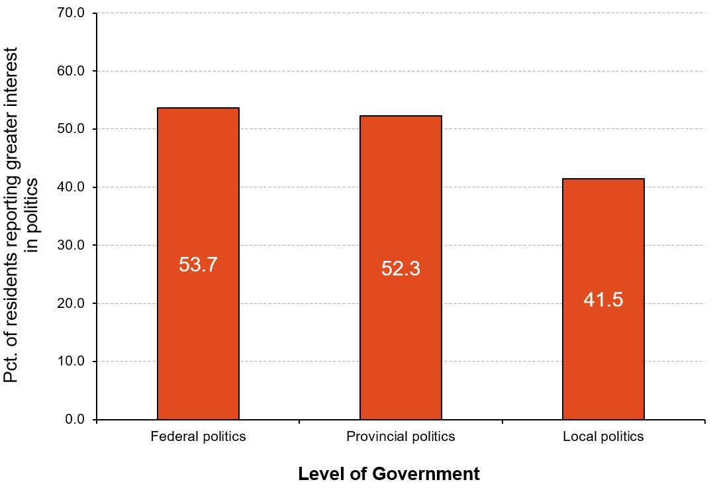
Overall interest in politics
Notes:
Democratic Engagement
“How interested are Nova Scotians in different levels of politics?”
More Nova Scotians indicated that they have greater interest in federal and provincial politics than in local (or band) politics.
Over half of Nova Scotians express greater interest in federal politics (53.7%) and in provincial politics (52.3%) than in local politics. More than 10% fewer Nova Scotians report having greater interest in local politics (41.5%).
‹#›

Slide 29
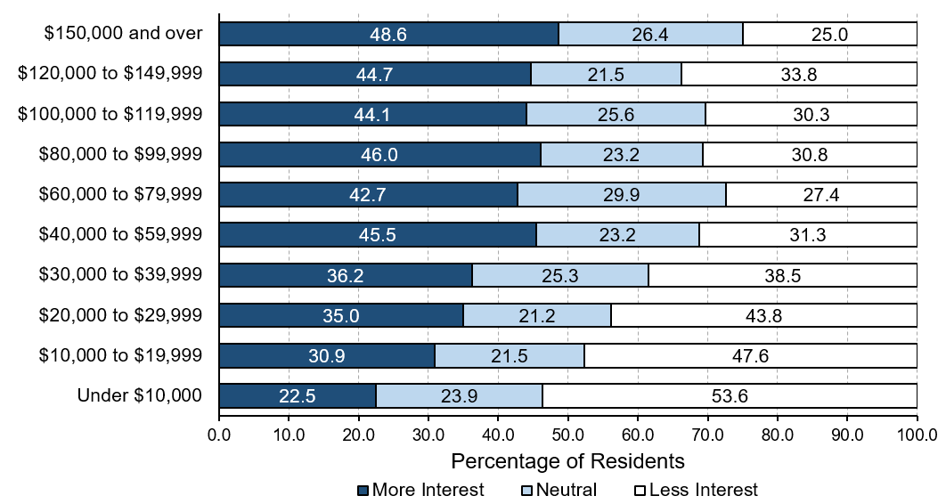
Interest in local politics by income
Notes:
Democratic Engagement
“Is interest in local politics related to household income?”
Generally, as annual household incomes increase, interest in local politics also increases.
Over one-third (38.5%) to more than half (53.6%) of residents with household incomes less than $40,000 per year are not interested in local politics.
One-quarter of residents with annual household incomes of $150,000 and over (25.0%) are not interested in local politics; in contrast, almost half of these residents in the highest income category (48.6%) are very interested in local politics.
‹#›

Slide 30
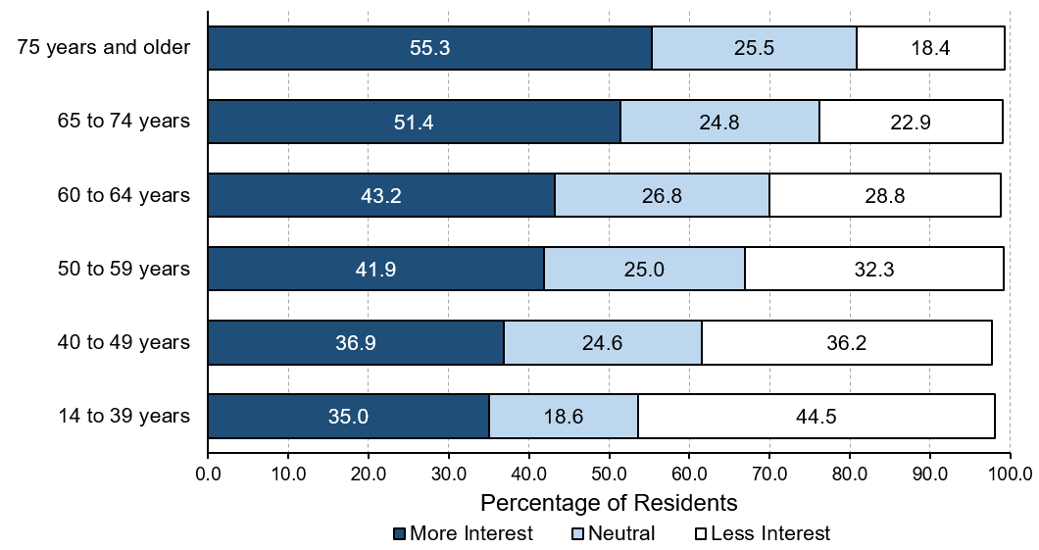
Interest in local politics by age
Notes:
Democratic Engagement
“Is interest in local politics related to age?”
The percentage of Nova Scotians interested in local politics steadily increases as they get older.
Just over one-third of younger residents, under 40 years of age, (35.0%) are very interested in local politics compared to over half of older residents (65 years of age and older) who express greater interest in local politics (51.4% to 55.3%).
‹#›

Slide 31
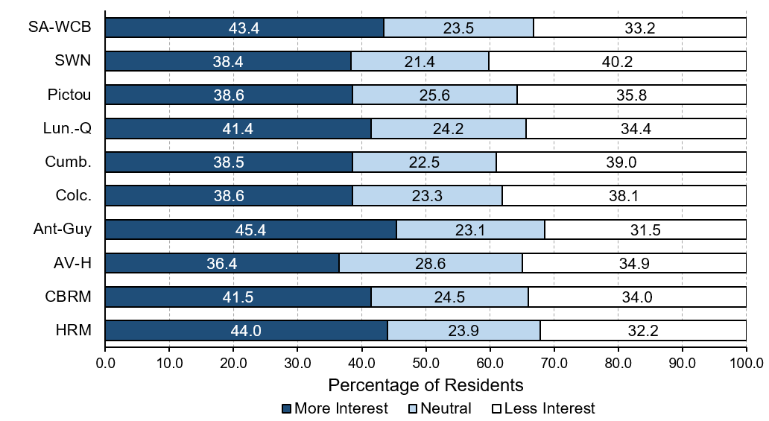
Interest in local politics by region
Notes:
Democratic Engagement
“Is interest in local politics related to the region where Nova Scotians live?”
The regions with the highest percentage of residents with greater interest in local politics are Antigonish-Guysborough (45.4%), Halifax Regional Municipality (44.0%), and Strait Area-West Cape Breton (43.4%).
In contrast, the regions with the highest percentage of residents with very little interest in local politics are South West Nova (40.2%), Cumberland (39.0%), and Colchester (38.1%).
‹#›

Slide 32
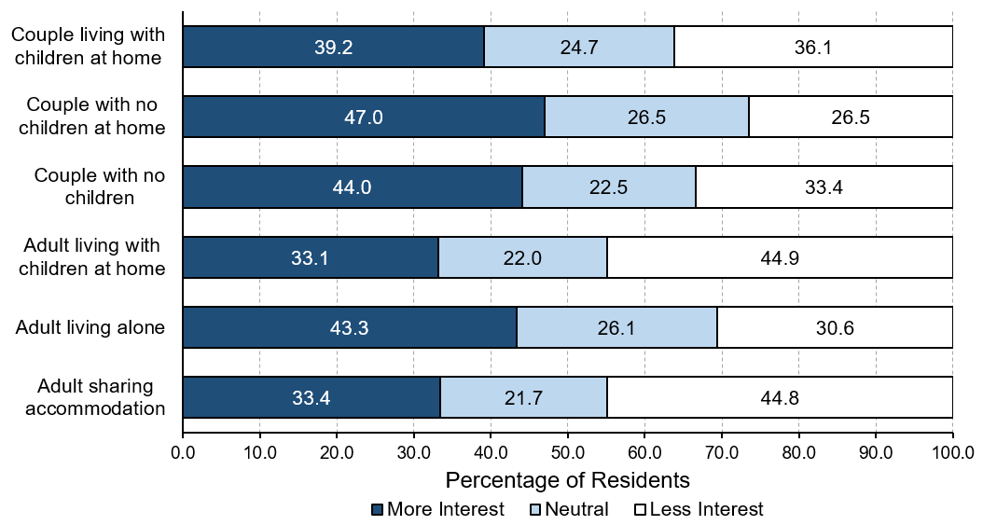
Interest in local politics by living arrangement
Notes:
Democratic Engagement
“Is interest in local politics related to living arrangements?”
Just under half of couples with no children living at home (47.0%), couples with no children (44.0%), and adults living alone (43.3%) express greater interest in local politics.
In contrast, one-third of single parents (33.1%) and adults sharing accommodation with others (33.4%) report greater interest in local politics – more than 10% fewer than couples.
‹#›

Slide 33
Education
Notes:
Education
Education is the systematic instruction, schooling, or training given to the young in preparation for the work of life, and by extension, similar instruction or training obtained in adulthood.
Societies that thrive encourage a thirst for knowledge – at every age and stage of life. Education is a process that begins before school age and is reflected in pre-school arrangements such as child care and early childhood education. Children are born ready to learn – the experiences and relationships in the years leading up to school age influence the capacity for learning. It also continues beyond elementary and high school, to college, university, and professional training through apprenticeships. Education continues as lifelong learning. As the world changes, education helps Canadians adapt to new challenges.
In this section on Education, we look at Nova Scotians’ reasons for taking formal education courses and the percentage who took courses for interest either in the community or online during the past year.
‹#›

Slide 34
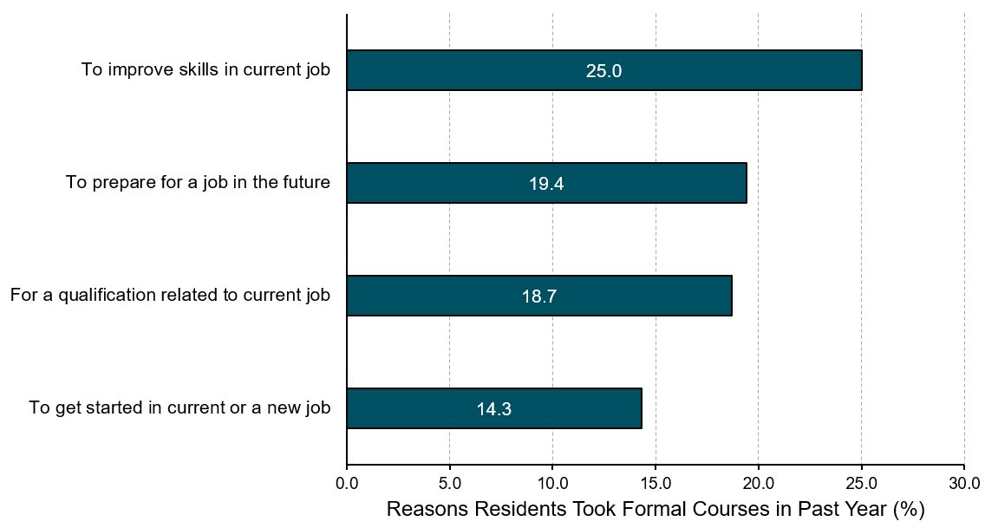
Reasons for taking formal educational courses
Notes:
Education
“What are the main reasons residents take formal educational courses?”
One-quarter of Nova Scotians (25.0%) who took formal educational courses in the past year did so to improve skills for their current job. This was the most frequently cited reason.
About one in five Nova Scotians took formal education courses to prepare for a job in the future (19.4%) or to obtain a qualification related to their current job (18.7%).
Comparatively fewer residents (14.3%) took formal educational courses to get started in a current or a new job.
‹#›

Slide 35
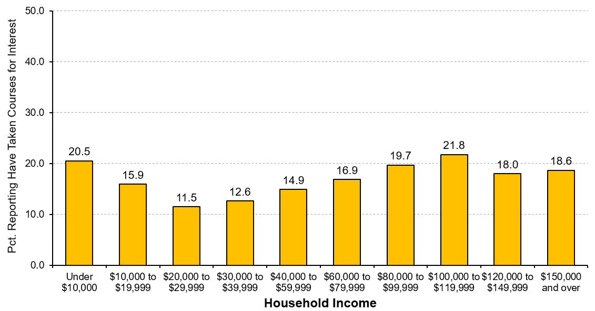
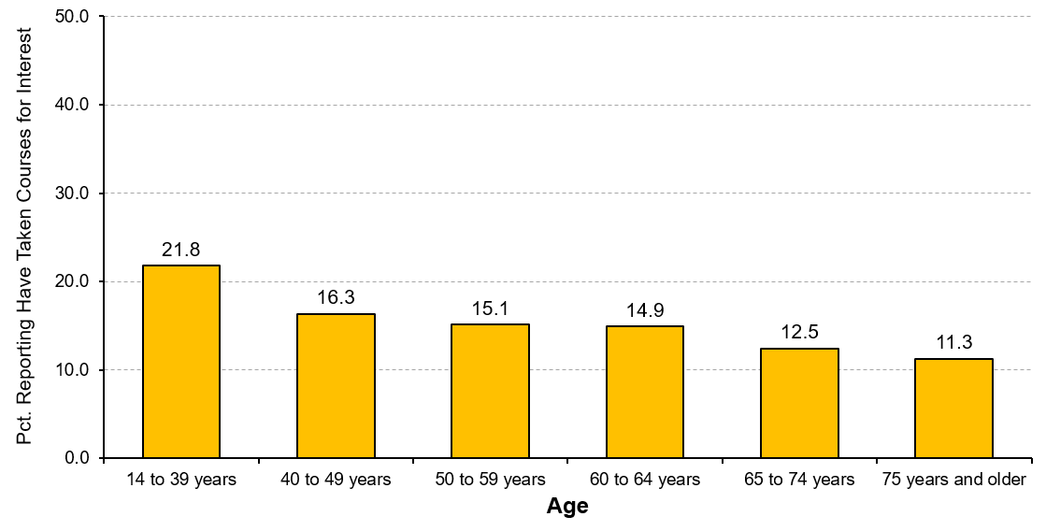
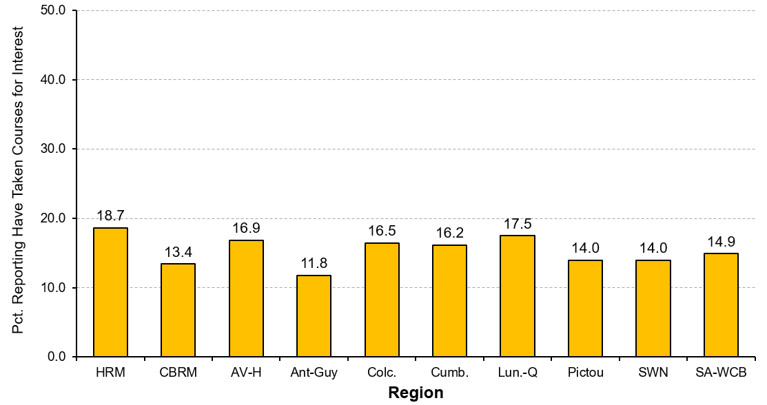
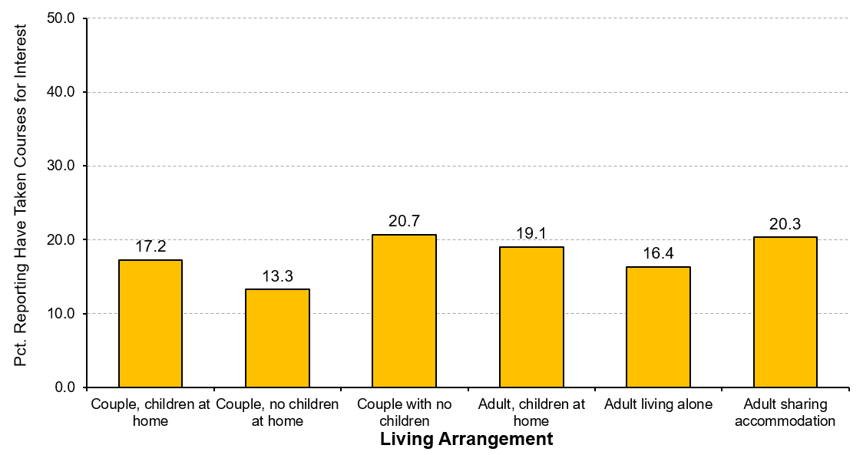
Taking courses for interest
INCOME
AGE
REGION
LIVING ARRANGEMENT
Notes:
Education
“Which Nova Scotians took courses for interest in the past year?”
Increases in annual household income are generally related to higher percentages of residents taking course for interest. With each increase in annual household income from $40,000 to $120,000, an increasing percentage of residents took courses for interest in the past year. Except for those with incomes under $10,000 per year (20.5%), a higher percentage of those residents with annual household incomes over $100,000 per year took courses for interest.
As Nova Scotians get older, they are less likely to take courses for interest. Younger residents – those from 14 to 39 years of age – were most likely to take courses for interest in the past year (21.8%).
People residing in Halifax Regional Municipality (18.7%) and in Lunenburg-Queens (17.5%) were the most likely to take courses for interest in the past year, while residents of Antigonish-Guysborough (11.8%) and Cape Breton Regional Municipality (13.4%) were least likely to take courses for interest.
Nova Scotians with quite different living arrangements were just as likely to take courses for interest in the past year. Couples with no children (20.7%), adults sharing accommodations (20.3%), and single parents (19.1%) were most likely to take courses for interest while couples with no children at home were least likely to do so (13.3%).
‹#›

Slide 36
Taking courses for interest
INCOME
Notes:
Graph from slide 35: Income.
‹#›

Slide 37
Taking courses for interest
AGE
Notes:
Graph from slide 35: Age.
‹#›

Slide 38
Taking courses for interest
REGION
Notes:
Graph from slide 35: Region.
‹#›

Slide 39
Taking courses for interest
LIVING ARRANGEMENT
Notes:
Graph from slide 35: Living Arrangement.
‹#›

Slide 40
Environment
Notes:
Environment
The environment is the foundation upon which human societies are built and the source of our sustained wellbeing. On a broader level, environmental protection involves the prevention of waste and damage while revitalizing our ecosystems and working towards the sustainability of all of our natural resources.
The environment is the basis for our health, our communities, and our economy. Despite its fundamental importance to human existence and the natural resource wealth it provides to Canada, we often fail to appreciate the various ecosystem services provided by nature that sustain human wellbeing. Indeed, our wellbeing is influenced directly by the quality of our air, soil, and water.
In this section on the Environment, we look at Nova Scotians’ perceptions of: (1) the quality of the environment in their community, (2) the opportunities to enjoy nature, and (3) traffic congestion in their community.
‹#›

Slide 41
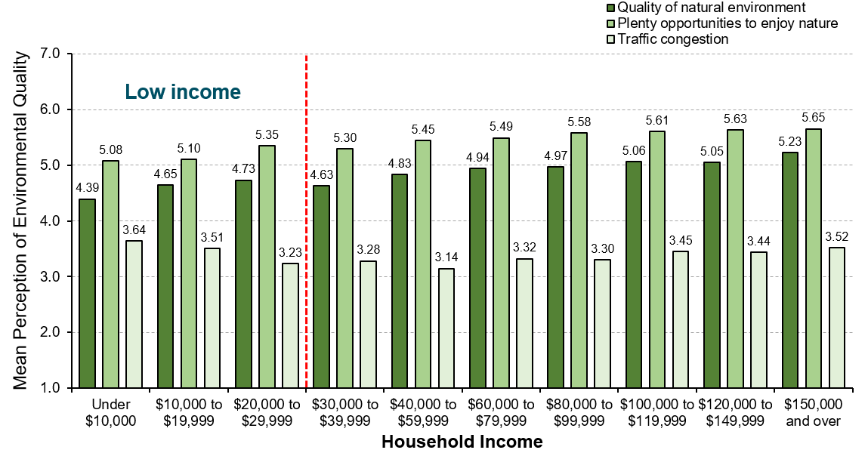
Perceived environmental quality by income
Notes:
Environment
“How do residents with different annual household incomes perceive the quality of the environment in their community?”
As their annual household incomes increase, Nova Scotians agree more that the quality of the natural environment in the community is higher.
As their annual household incomes increase, Nova Scotians agree more that there are plenty of opportunities to enjoy nature in their community.
Traffic congestion in their community is seen as a problem more so by residents with the lowest (under $20,000 per year) and the highest (over $100,000 per year) incomes.
Note: Averages are based on a 7-point scale where 1=very strongly disagree and 7=very strongly agree.
‹#›

Slide 42
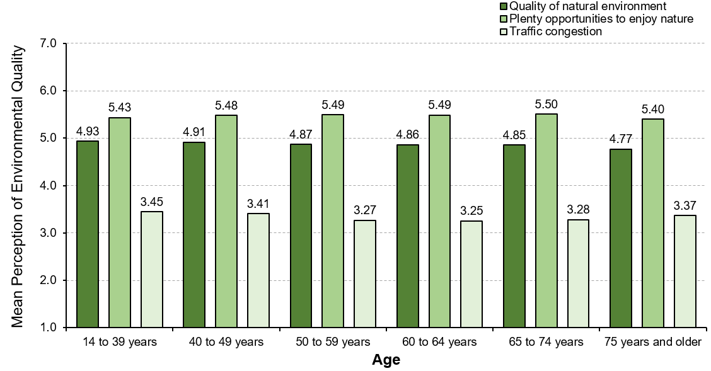
Perceived environmental quality by age
Notes:
Environment
“How do residents of different ages perceive the quality of the environment in their community?”
Regardless of age, residents feel the quality of the natural environment is very good and that there are plenty of opportunities to enjoy nature in their community. Only those residents 75 years and older feel somewhat less strongly about these two aspects of their natural environment.
Age does not appear to be related to residents’ perceptions of traffic congestion in their community. Nova Scotians of all ages perceive traffic congestion fairly similarly.
Note: Averages are based on a 7-point scale where 1=very strongly disagree and 7=very strongly agree.
‹#›

Slide 43
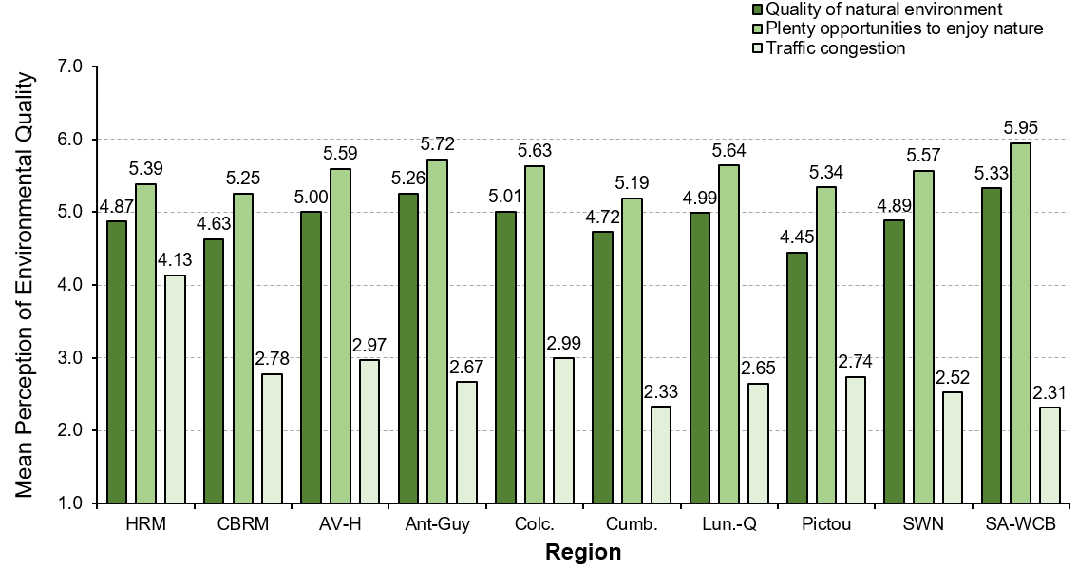
Perceived environmental quality by region
Notes:
Environment
“How do residents in different regions of Nova Scotia perceive the quality of the environment in their community?”
Residents living in Strait Area-West Cape Breton agree most strongly that the quality of the natural environment is good in the community, followed closely in that view by residents living in Antigonish-Guysborough. In contrast, even though residents living in Pictou agree the quality of the natural environment is reasonably good, they report the lowest ratings of any region in the province.
Residents of all regions in Nova Scotia generally agree that there are plenty of opportunities to enjoy nature in their community, and in particular, residents living in Strait Area-West Cape Breton agree significantly more strongly than residents of any other region. While residents living in Cumberland and in Cape Breton Regional Municipality still agree fairly strongly there are plenty of opportunities to enjoy nature in the community, their ratings are lower than any other region in the province.
Significantly more so than Nova Scotians living any where in the province, residents of Halifax Regional Municipality agree strongly that traffic congestion is a problem in their community.
Note: Averages are based on a 7-point scale where 1=very strongly disagree and 7=very strongly agree.
‹#›

Slide 44
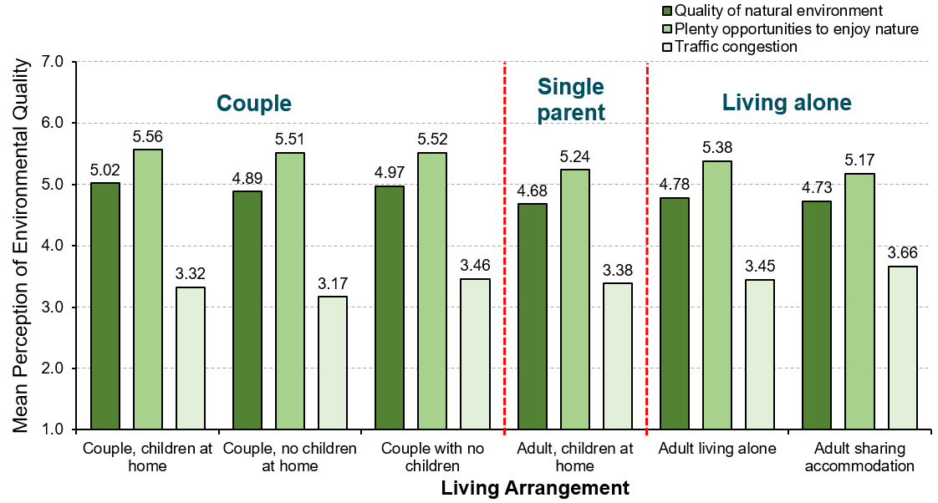
Perceived environmental quality by living arrangement
Notes:
Environment
“How do residents with different living arrangements perceive the quality of the environment in their community?”
Households comprised of couples, whether or not there are children living at home, agree more strongly than residents in any other living arrangement that both the quality of natural environment and opportunities to enjoy nature are very good in their community.
Households with adults sharing accommodation with others agree more strongly that traffic congestion is a problem in the community.
Overall, single parent families generally report lower levels of agreement than most residents in other living arrangements on all aspects of the perceived quality of the environment in the community.
Note: Averages are based on a 7-point scale where 1=very strongly disagree and 7=very strongly agree.
‹#›

Slide 45
Healthy Populations
Notes:
Healthy Populations
The Healthy Populations domain considers the physical, mental, and social wellbeing of the population. It examines life expectancy, lifestyle and behaviours, and the circumstances that influence health, such as access to health care.
Healthy populations captures both the overall health of the population (“health status”) as well as factors that influence health (“health determinants”). This broad perspective is used because peoples’ lifestyles and behaviours are constrained and shaped by broader social factors such as how food is distributed and priced, how houses are constructed and located, how urban transportation is designed, how easily people can access health care and recreational services, and how we interact with the natural environment.
In this section on Healthy Populations, we look at the extent to which Nova Scotians agree that they engage in health-related behaviours. In particular: (1) their substance use (e.g., recreational drugs), (2) their engagement in good quality exercise, and (3) their efforts to eat healthy meals on a regular basis.
‹#›

Slide 46
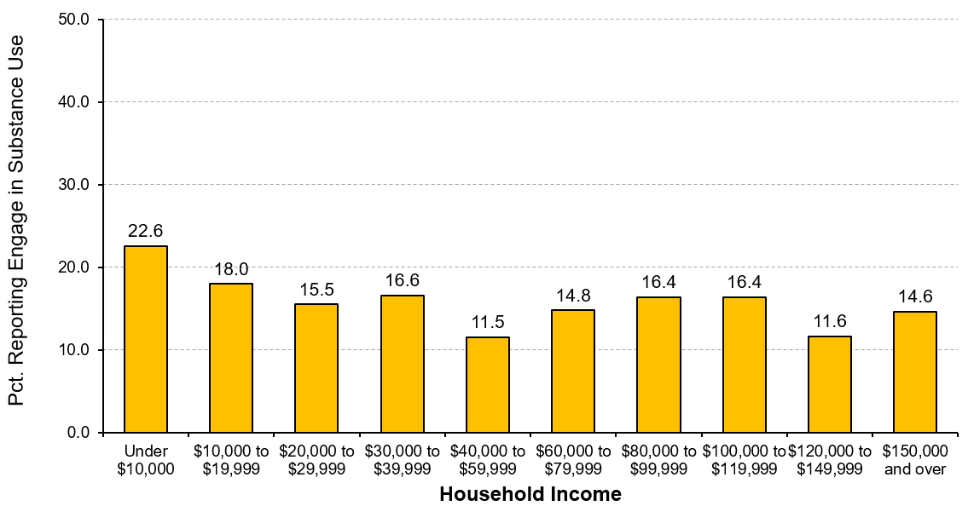
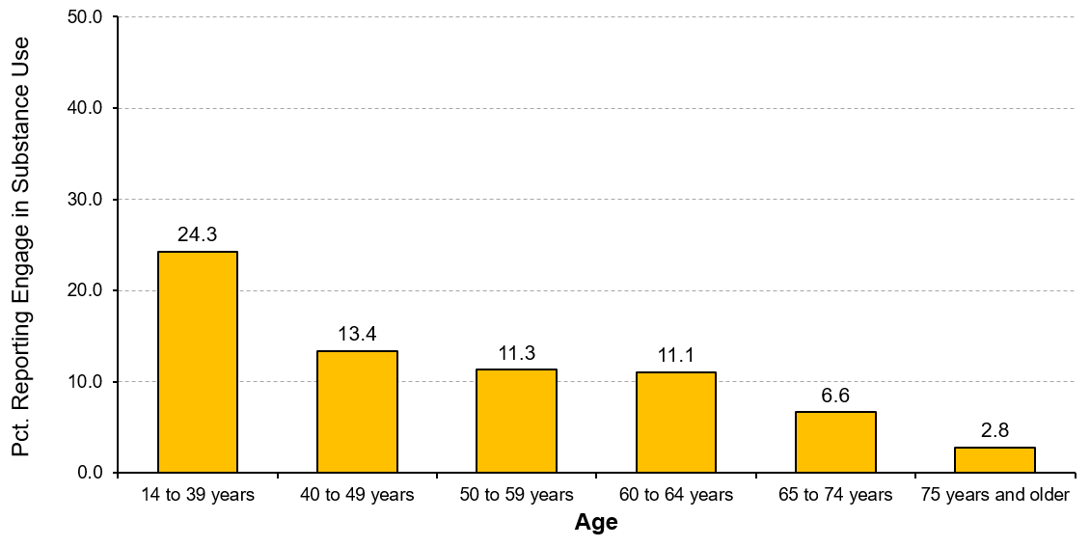
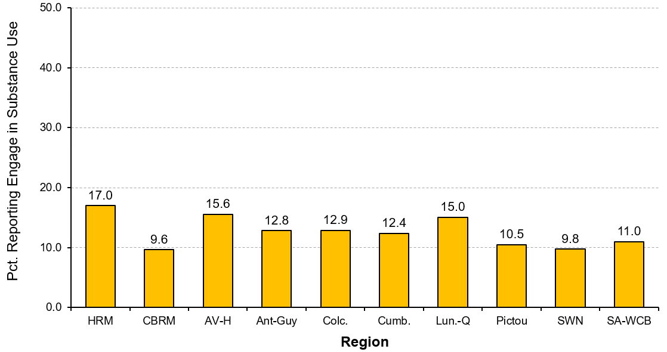
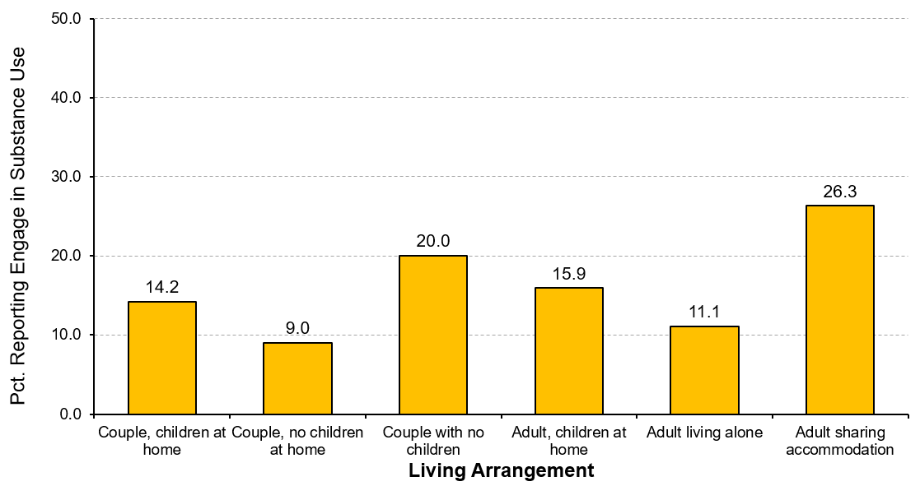
Engage in substance use
INCOME
AGE
REGION
LIVING ARRANGEMENT
Notes:
Healthy Populations
“To what extent did Nova Scotians engage in substance use (i.e., recreational drugs) in the past week?”
A higher percentage of residents living on annual household incomes less than $20,000 were more likely to engage in substance use in the past week (over 18.0%) with those with incomes under $10,000 significantly higher (22.6%) than any other income group.
Almost one in four residents under 40 years of age (24.3%) engaged in substance in the past week, which is more than twice the percentage of residents over 40 years. The percentage of residents engaged in substance use decreases significantly as residents age.
Residents living in Halifax Regional Municipality (17.0%), Annapolis Valley-Hants (15.5%), and Lunenburg-Queens (15.0%) were the most likely to engage in substance use in the past week, compared to fewer than one in ten residents of South West Nova (9.8%) and Cape Breton Regional Municipality (9.6%).
A much higher percentage of residents who are sharing accommodation with others (26.3%) were the most likely to engage in substance use in the past week.
Note: Percentages based on all of those residents who agreed they used recreational drugs in the past week (i.e., those who scored 5 or higher on a 7-point agreement scale).
‹#›

Slide 47
Engage in substance use
INCOME
Notes:
Graph from slide 46: Income.
‹#›

Slide 48
Engage in substance use
AGE
Notes:
Graph from slide 46: Age.
‹#›

Slide 49
Engage in substance use
REGION
Notes:
Graph from slide 46: Region.
‹#›

Slide 50
Engage in substance use
LIVING ARRANGEMENT
Notes:
Graph from slide 46: Living Arrangement.
‹#›

Slide 51
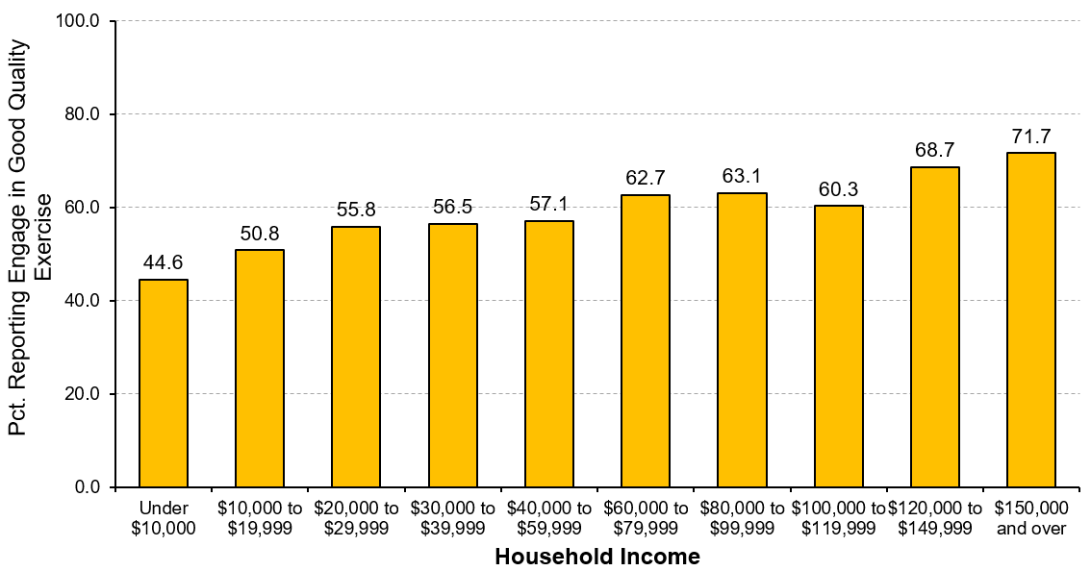
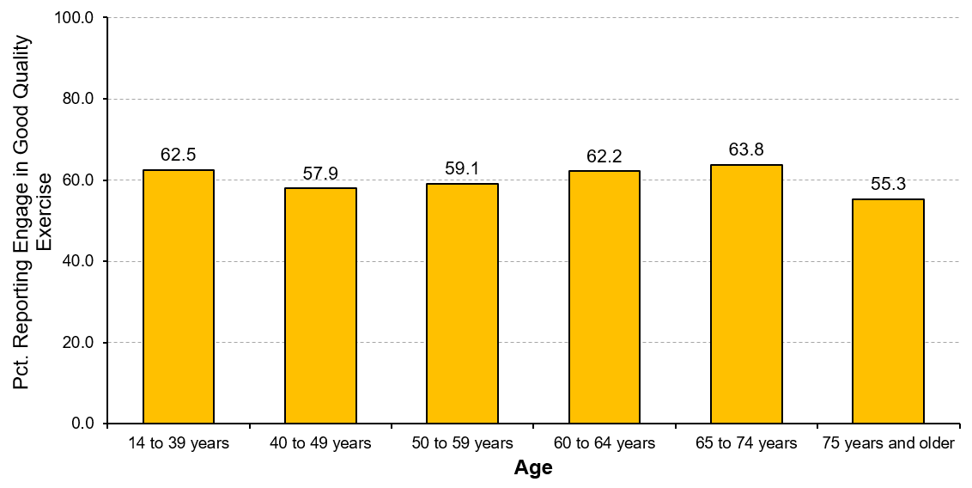
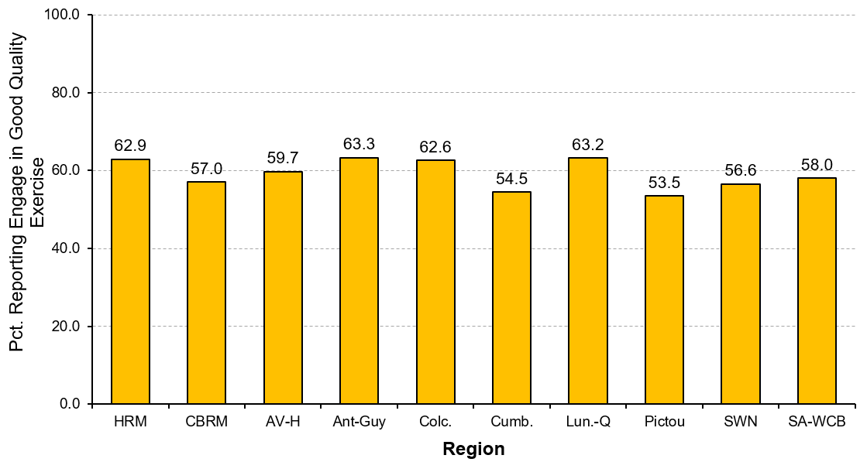
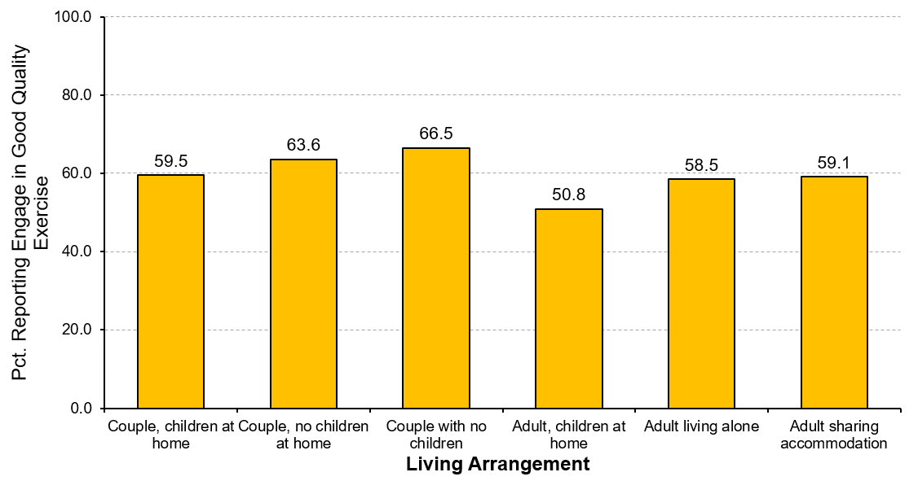
Engage in good quality exercise
INCOME
AGE
REGION
LIVING ARRANGEMENT
Notes:
Healthy Populations
“To what extent did Nova Scotians engage in good quality exercise in the past week?”
Generally, as annual household income increases, so did engagement in good quality exercise in the past week. Under half of residents with annual incomes of under $10,000 (44.6%) engaged in good quality exercise compared to more than seven in ten residents with annual incomes over $150,000 (71.7%).
Approximately six in ten residents in all age groups engaged in good quality exercise in the past week (57.9% to 63.8%). Only the percentage of those residents 75 years and older was lower and yet more than half (55.3%) are still reporting an active lifestyle.
Approximately six in ten residents living in most regions of Nova Scotia engaged in good quality exercise in the past week (56.6% to 63.3%). The percentage was slightly lower – but still above half – in Pictou (53.5%) and Cumberland (54.5%).
Almost two-thirds of couples having no children (66.5%) and couples with no children living at home (63.6%) engaged in good quality exercise in the past week. Just over half of single parents (50.8%) households reported getting quality exercise in the past week.
Note: Percentages based on all of those residents who agreed they got quality exercise in the past week (i.e., those who scored 5 or higher on a 7-point agreement scale).
‹#›

Slide 52
Engage in good quality exercise
INCOME
Notes:
Graph from slide 51: Income.
‹#›

Slide 53
Engage in good quality exercise
AGE
Notes:
Graph from slide 51: Age.
‹#›

Slide 54
Engage in good quality exercise
REGION
Notes:
Graph from slide 51: Region.
‹#›

Slide 55
Engage in good quality exercise
LIVING ARRANGEMENT
Notes:
Graph from slide 51: Living Arrangement.
‹#›

Slide 56
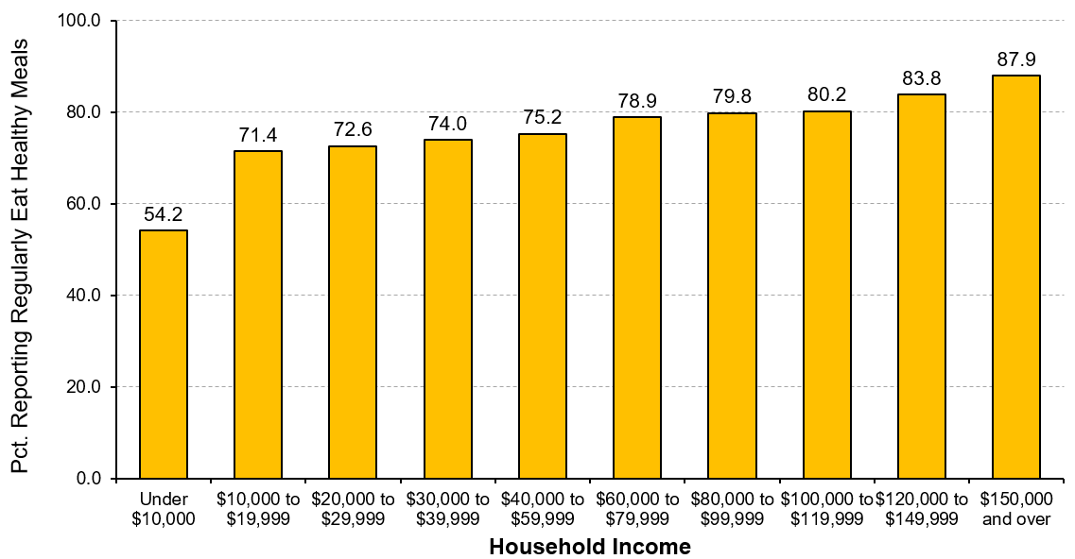
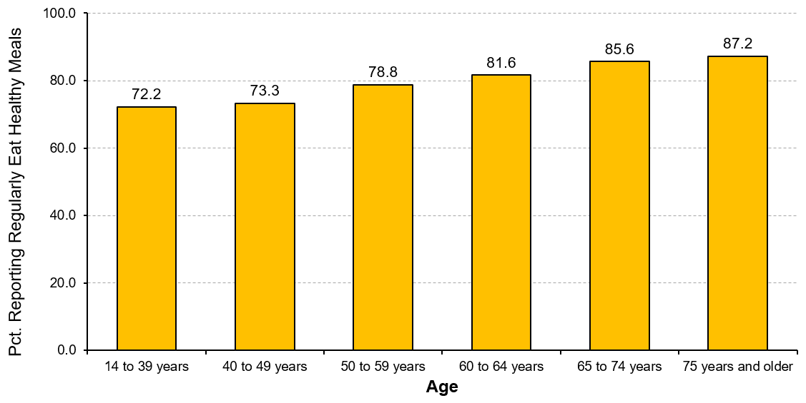
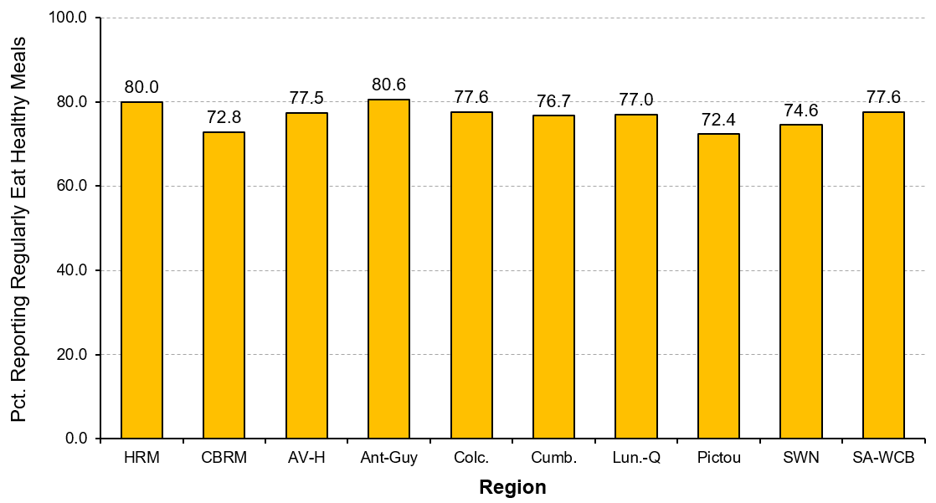
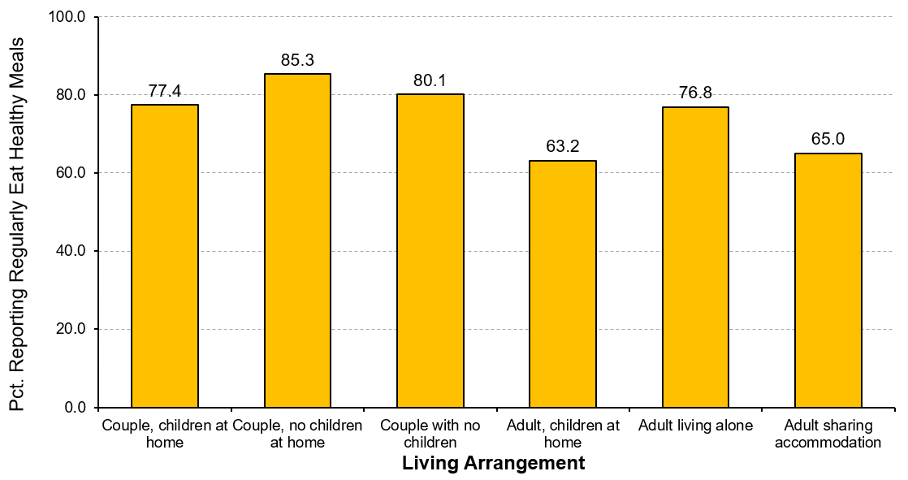
Ate healthy meals
INCOME
AGE
REGION
LIVING ARRANGEMENT
Notes:
Healthy Populations
“To what extent did Nova Scotians regularly eat healthy meals in the past week?”
The percentage of residents who regularly ate healthy meals in the past week steadily increased as annual household income increased, rising steadily from 71.4% to 87.9%. Of concern is residents with incomes under $10,000 per year because just over half (54.2%) are eating healthy meals each week, which is about 20 to 30% fewer than all other income groups.
The percentage of residents regularly eating healthy meals each week increases as they get older, rising steadily from just over seven in ten of those under 40 years (72.2%) to almost nine in ten of those residents 75 years of age and older (87.2%).
About 75% to 80% of residents in most regions across Nova Scotia report regularly eating healthy meals each week. Only in Pictou (72.4%) and in Cape Breton Regional Municipality (72.8%) is the percentage of residents slightly lower.
The percentage of households with single parent families (63.2%) and with adults sharing accommodation with others (65.0%) are the least likely to regularly eat healthy meals each week compared to over three-quarters of all other household types.
Note: Percentages based on all of those residents who agreed they regularly ate healthy meals in the past week (i.e., those who scored 5 or higher on a 7-point agreement scale).
‹#›

Slide 57
Ate healthy meals
INCOME
Notes:
Graph from slide 56: Income.
‹#›

Slide 58
Ate healthy meals
AGE
Notes:
Graph from slide 56: Age.
‹#›

Slide 59
Ate healthy meals
REGION
Notes:
Graph from slide 56: Region.
‹#›

Slide 60
Ate healthy meals
LIVING ARRANGEMENT
Notes:
Graph from slide 56: Living Arrangement.
‹#›

Slide 61
Leisure and Culture
Notes:
Leisure and Culture
By participating in leisure and cultural activities, whether arts, culture, or recreation, we contribute to our wellbeing as individuals, to our communities, and to society as a whole. The myriad of activities and opportunities we pursue and enjoy benefit our overall life satisfaction and quality of life.
As forms of human expression, leisure and cultural activities help to more fully define our lives, the meaning we derive from them, and ultimately, our wellbeing. This remains true throughout our lives regardless of age, gender, or social group. The impact of participation in leisure and cultural activities is even greater for people in marginalized groups, such as those living with disabilities, living in poverty, and as members of a minority population.
In this section on Leisure and Culture, we look at several factors associated with Nova Scotians’ use of their leisure time: (1) their participation in a variety of leisure activities –socialising with friends, playing team sports, and playing a musical instrument; (2) their use of recreation and cultural facilities in their community; and (3) the perceived accessibility to those facilities.
‹#›

Slide 62
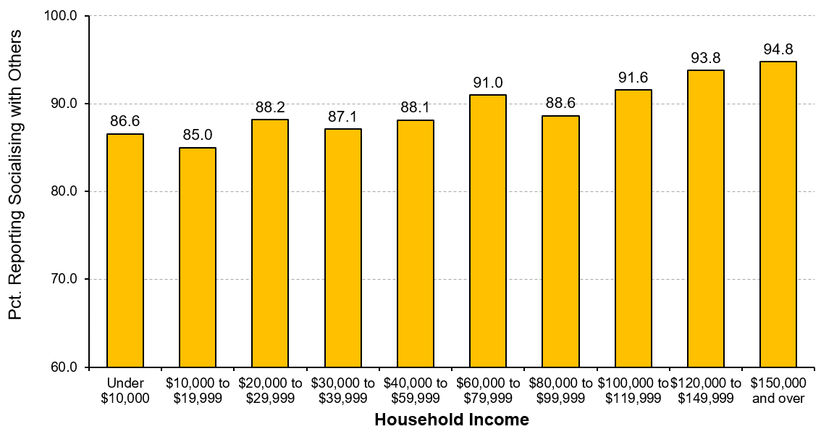
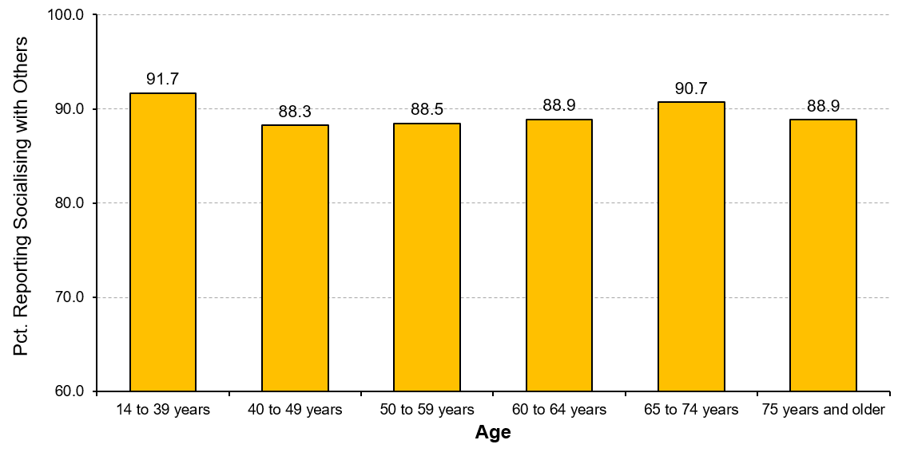
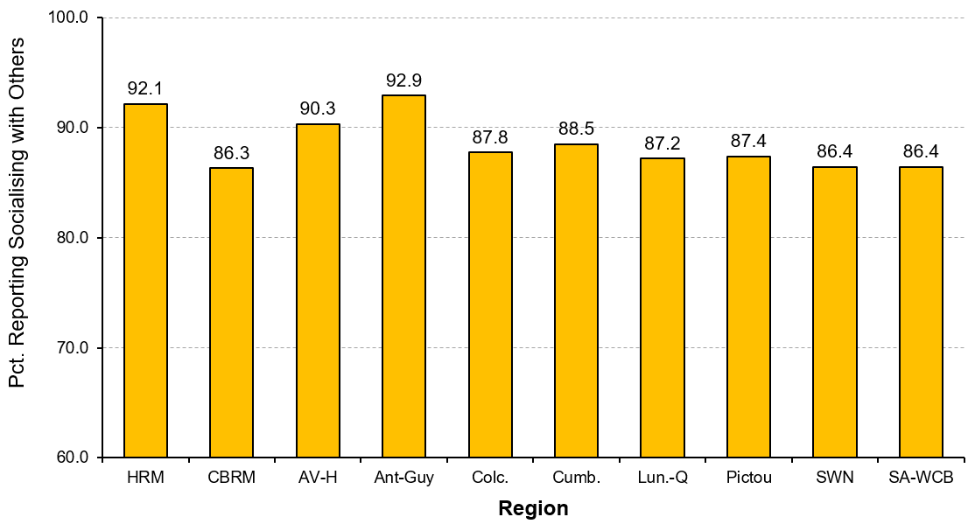
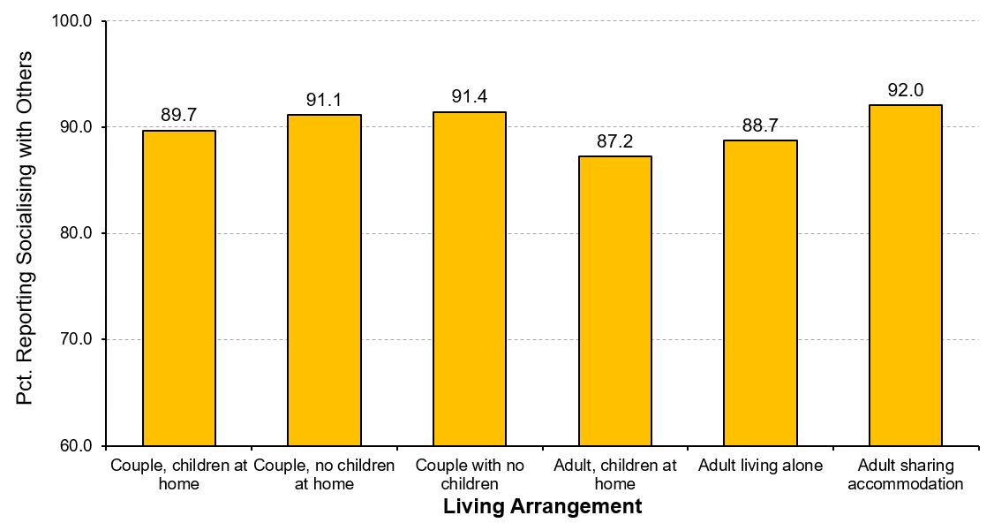
Socialising with friends
INCOME
AGE
REGION
LIVING ARRANGEMENT
Notes:
Leisure and Culture
“What percentage of Nova Scotians socialise with friends?”
Nine in ten Nova Scotians (89.9%) socialise with friends as part of their leisure time and do so on average about twice per week.
Annual household income is associated with socialising with friends. As income increases, so does the percentage of residents who participate in leisure activities in which they can socialise with friends.
There is little variation in the percentage of residents who socialise with friends based on age. Approximately 88% to 92% of residents of all ages report socialising with friends during their leisure time.
A higher percentage of residents living in Antigonish-Guysborough (92.9%) and in Halifax Regional Municipality (92.1%) socialise with friends during their leisure time. While still high, a comparatively slightly lower percentage of residents in Cape Breton Regional Municipality (86.3%), in South West Nova (86.4%) and in Strait Area-West Cape Breton (86.4%) socialise with friends.
Living arrangements do not appear to significantly affect the percentage of Nova Scotians who socialise with friends in their leisure time. However, a somewhat lower percentage of single parents (87.2%) and adults living alone (88.7%) report socialising with friends.
‹#›

Slide 63
Socialising with friends
INCOME
Notes:
Graph from slide 62: Income.
‹#›

Slide 64
Socialising with friends
AGE
Notes:
Graph from slide 62: Age.
‹#›

Slide 65
Socialising with friends
REGION
Notes:
Graph from slide 62: Region.
‹#›

Slide 66
Socialising with friends
LIVING ARRANGEMENT
Notes:
Graph from slide 62: Living Arrangement.
‹#›

Slide 67
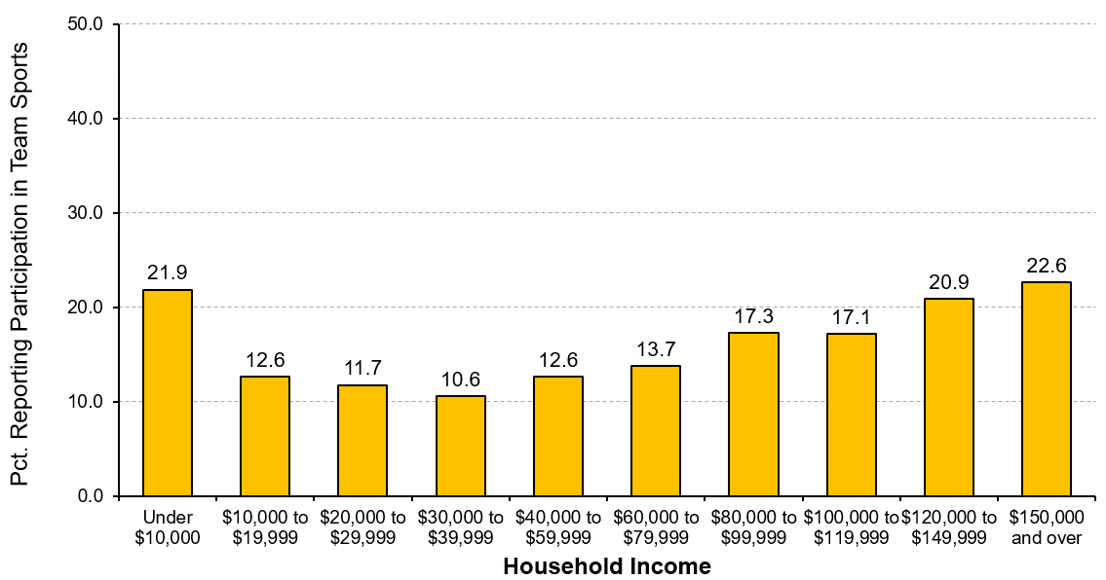
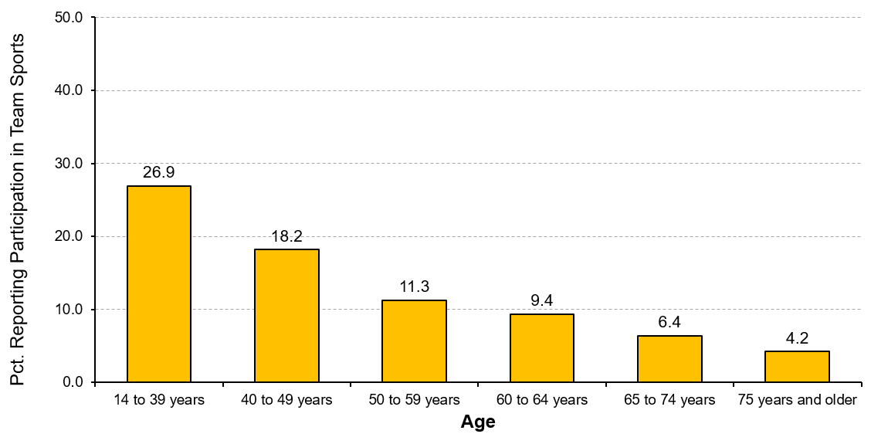
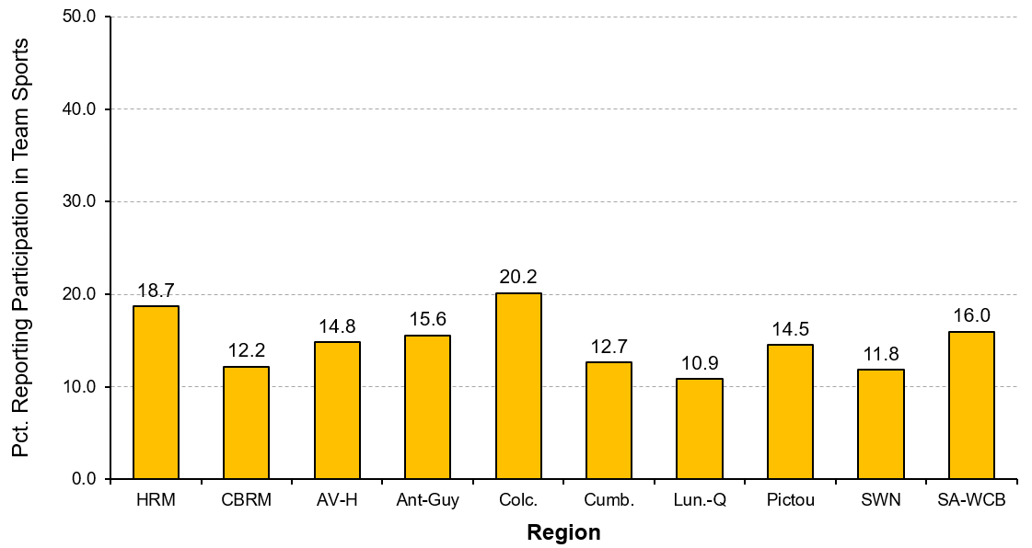
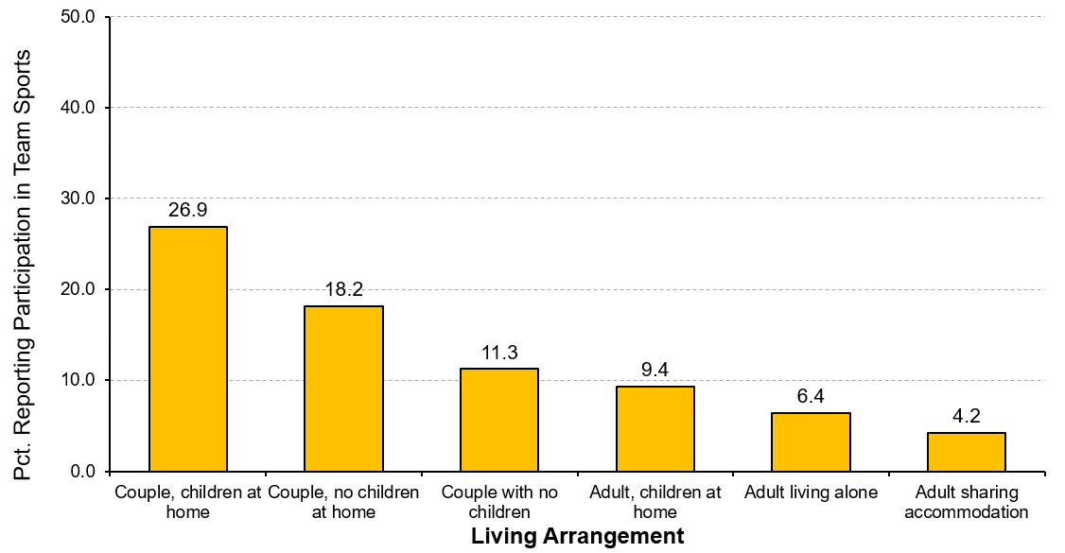
Participation in team sports
INCOME
AGE
REGION
LIVING ARRANGEMENT
Notes:
Leisure and Culture
“What percentage of Nova Scotians participate in team sports?”
Overall, just over 16% of Nova Scotians participate in team sports (e.g., baseball, hockey, volleyball, basketball).
Generally, as annual household income increases, so does the percentage of Nova Scotians that participate in team sports, rising from just over one in ten among those with incomes from $30,000 to $39,999 (10.6%) to almost one-quarter of those with incomes of $150,000 and over (22.6%). A notable exception is residents with annual household incomes under $10,000 – over one in five (21.9%) participate in team sports.
The percentage of Nova Scotians who participate in team sports steadily decreases as people age. Over one-quarter of younger residents (i.e., 14 to 39 years of age) participate in team sports (26.9%) while fewer than one in 20 older residents (i.e., 75 years and older) participate (4.2%).
Rates of participation in team sports varies by region in Nova Scotia with the lowest percentage of residents in Lunenburg-Queens participating in teams sports (10.9%) and the highest percentage of participants in Colchester (20.2%).
A considerably higher percentage of couples with children living at home participate in team sports (26.9%) than the percentages of residents in all other living arrangements. In fact, their rate of participation is more than twice to six times higher than all other groups that except for couples with no children at home (18.2%).
‹#›

Slide 68
Participation in team sports
INCOME
Notes:
Graph from slide 67: Income.
‹#›

Slide 69
Participation in team sports
AGE
Notes:
Graph from slide 67: Age.
‹#›

Slide 70
Participation in team sports
REGION
Notes:
Graph from slide 67: Region.
‹#›

Slide 71
Participation in team sports
LIVING ARRANGEMENT
Notes:
Graph from slide 67: Living Arrangement.
‹#›

Slide 72
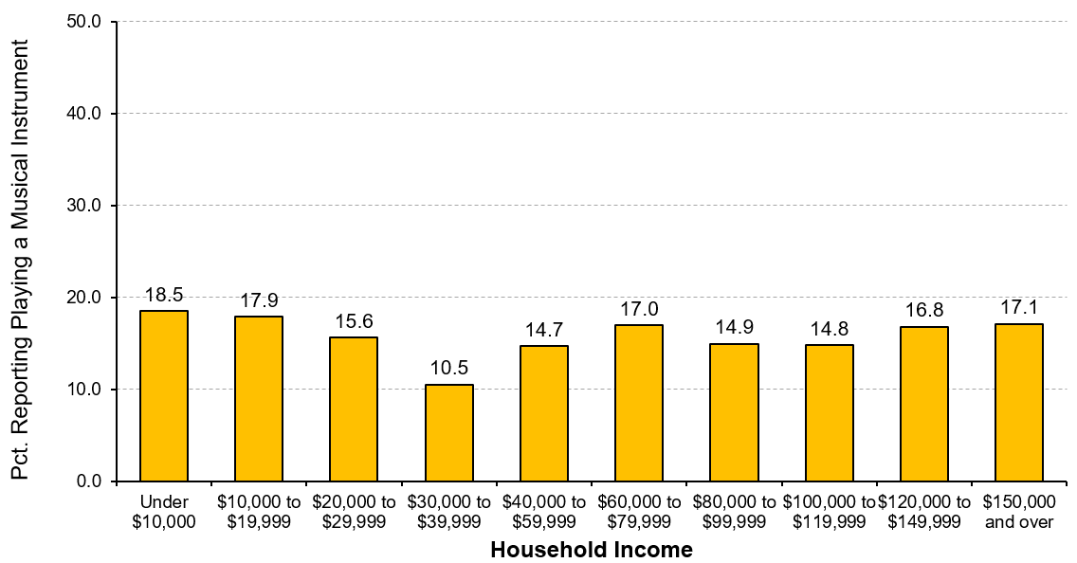
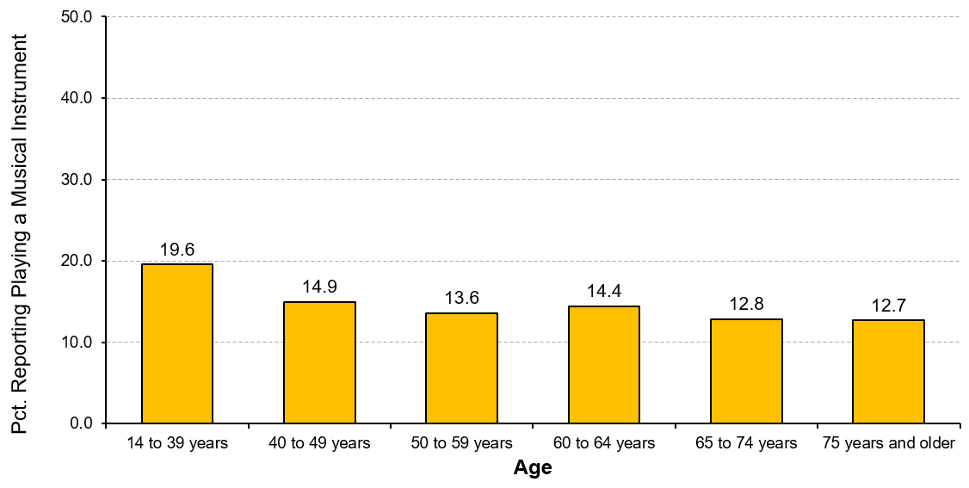
Playing a musical instrument
INCOME
AGE
REGION
LIVING ARRANGEMENT
Notes:
Leisure and Culture
“What percentage of Nova Scotians play a musical instrument?”
Just over 15% of Nova Scotians play a musical instrument (15.7%) and do so on average three to four times per week.
Overall, there are few variations in playing a musical instrument based on annual household income. The one notable exception is for residents with incomes of $30,000 to $39,999 – one in ten residents play a musical instrument (10.5%), which is much lower rate than in other income categories.
A higher percentage of younger residents (i.e., 14 to 39 years of age) play a musical instrument during their leisure time (19.6%), which is about 5% to 6% higher than older age groups.
Rates of participation in playing a musical instrument varies by region in Nova Scotia with the lowest percentage of residents in Pictou participating (10.5%) and the highest percentage of participants in Halifax Regional Municipality (17.8%) and in Annapolis Valley-Hants (16.7%).
The percentage of Nova Scotians who play a musical instrument is fairly similar in all types of living arrangements, with the rate of participation in households of couples with children living at home being comparatively higher (19.6%).
‹#›

Slide 73
Playing a musical instrument
INCOME
Notes:
Graph from slide 72: Income.
‹#›

Slide 74
Playing a musical instrument
AGE
Notes:
Graph from slide 72: Age.
‹#›

Slide 75
Playing a musical instrument
REGION
Notes:
Graph from slide 72: Region.
‹#›

Slide 76
Playing a musical instrument
LIVING ARRANGEMENT
Notes:
Graph from slide 72: Living Arrangement.
‹#›

Slide 77
Facility use in Nova Scotia
Use of Recreation and Cultural Facilities
Notes:
Leisure and Culture
“What percentage of Nova Scotians used a variety of recreation and cultural facilities in the past year?”
The highest percentage of residents reported using two types of outdoor recreation opportunities in the past year. Over eight in ten residents (83.4%) report using local parks, playgrounds, and trails, and seven in ten residents (70.0%) used beaches and/or outdoor swimming pools.
In the past year, over half of Nova Scotians reported using their public library (58.1%), an historic site or museum (56.8%), and a community complex or recreation centre (54.5%).
A much smaller percentage of residents used curling rinks (8.7%) in the past year, and about one in five used an outdoor skating rink (19.4%) in the past year.
‹#›

Slide 78
Perceived accessibility of facilities by income
Notes:
Leisure and Culture
“How do Nova Scotians with different household incomes perceive the accessibility of recreation and cultural facilities?”
There is a clear relationship between annual household income and perceived access to recreation and cultural facilities – as household incomes increase, so too does perceived access. Specifically:
As incomes increase, residents agree more strongly that the recreation and cultural facilities are easy to get to.
As incomes increase, residents agree more strongly that the recreation programs are offered at convenient times.
As incomes increase, residents agree less strongly that the cost of programs prevents their participation.
Note: Averages are based on a 7-point scale where 1=very strongly disagree and 7=very strongly agree.
‹#›

Slide 79
Perceived accessibility of facilities by age
Notes:
Leisure and Culture
“How do Nova Scotians of different ages perceive the accessibility of recreation and cultural facilities?”
There is a clear relationship between age and perceived access to recreation and cultural facilities – as residents age, so too does perceived access. Specifically:
As Nova Scotians get older, they agree more strongly that the recreation and cultural facilities are easy to get to.
As Nova Scotians get older, they agree more strongly that the recreation programs are offered at convenient times.
As Nova Scotians get older, they agree less strongly that the cost of programs prevents their participation.
Note: Averages are based on a 7-point scale where 1=very strongly disagree and 7=very strongly agree.
‹#›

Slide 80
Perceived accessibility of facilities by region
Notes:
Leisure and Culture
“How do Nova Scotians living in different regions perceive the accessibility of recreation and cultural facilities?”
Residents living in Antigonish-Guysborough and in Colchester agree more strongly that recreation and cultural facilities are easy to get to.
Residents living in Antigonish-Guysborough and in Halifax Regional Municipality agree more strongly that programs are offered at convenient times.
Residents living in Pictou agree much more strongly that the cost of recreation and cultural programs prevents their participation. In contrast, residents living in Antigonish-Guysborough agree much less strongly that cost prevents their participation.
Note: Averages are based on a 7-point scale where 1=very strongly disagree and 7=very strongly agree.
‹#›

Slide 81
Perceived accessibility by living arrangement
Notes:
Leisure and Culture
“How do Nova Scotians with different living arrangements perceive the accessibility of recreation and cultural facilities?”
Households of couples, whether or not they have children, agree somewhat more strongly that recreation and cultural facilities are easy to get to compared to people in other living circumstances.
Single parents are much less likely to agree that recreation and culture programs are offered at convenient times. Couples with children living at home and couples having no children are somewhat less likely to agree that programs are offered at convenient times compared to people in other living arrangements..
Single parents are much more likely to agree that the cost of recreation and cultural programs prevents their participation. In contrast, couples with no children living at home are less likely to agree that cost is a barrier to their participation.
Note: Averages are based on a 7-point scale where 1=very strongly disagree and 7=very strongly agree.
‹#›

Slide 82
Living Standards
Notes:
Living Standards
Living Standards examines Canadians’ average and median income and wealth, distribution of income and wealth including poverty rates, income fluctuations and volatility. It considers economic security, including labour market security, and housing and food security.
Our living standards should reflect our capacity to transform economic growth into stable current and future income streams for everyone. Economic growth does not automatically translate into better living standards. A higher average income, for example, may be achieved at the cost of increased social inequality or greater economic insecurity. In contrast, achieving greater job quality, reducing poverty, and providing affordable housing and food security to individuals and families will raise wellbeing for everyone.
In this section on Living Standards, we look at several factors associated with the nature of Nova Scotians’ work: (1) their working arrangements, including whether or not they have flexible work hours, a regular work schedule, and if they work more than 50 hours per week; and (2) the to which there is imbalance in their work and personal life.
‹#›

Slide 83
Work flexibility
INCOME
AGE
REGION
LIVING ARRANGEMENT
Notes:
Living Standards
“Which Nova Scotians are more likely to have flexible work hours?”
Over half of Nova Scotians with annual household incomes of $150,000 and over report having flexible work hours (56.1%). Between about 35% and 45% of residents in other income groups have flexible work hours, except for those residents with incomes from $30,000 to $39,999 of whom just over one-quarter have flexible hours at work (27.9%).
Eight in ten older residents (i.e., 75 years and older) – 5.8% of whom are still working for pay – have flexible work hours. Similarly, six in ten residents from 65 to 74 years of age (60.0%) have flexible work hours (19.8% of this age group is still working for pay). A somewhat smaller percentage of Nova Scotians who are of typical working age (i.e., 21 to 64 years) have flexible working hours.
The percentage of Nova Scotians with flexible work hours is fairly similar in most regions, ranging from about 32% to 42%. Residents in Halifax Regional Municipality are more likely to have flexible works (47.6%) whereas residents in Cape Breton Regional Municipality are much less likely to have flexible work hours (28.7%).
Similar percentages of Nova Scotians in all living arrangements report having flexible work hours (about 38% to 46%). Notably, single parents are least likely have flexibility on their work hours (36.0%).
Note: Work flexibility only pertains to those residents who work for pay. Overall, about six in ten Nova Scotians (62.1%) reported that they work for pay.
‹#›

Slide 84
Work flexibility
INCOME
Notes:
Graph from slide 83: Income.
‹#›

Slide 85
Work flexibility
AGE
Notes:
Graph from slide 83: Age.
‹#›

Slide 86
Work flexibility
REGION
Notes:
Graph from slide 83: Region.
‹#›

Slide 87
Work flexibility
LIVING ARRANGEMENT
Notes:
Graph from slide 83: Living Arrangement.
‹#›

Slide 88
Regular weekday work schedule
INCOME
AGE
REGION
LIVING ARRANGEMENT
Notes:
Living Standards
“Which Nova Scotians are more likely to have a regular weekday work schedule?”
As annual household incomes increase, the percentage of residents with regular weekday work schedules increases. Over eight in ten residents with annual incomes of $150,000 and over (81.4%) have regular weekday work schedules whereas well below half of residents with annual incomes under $10,000 do (44.8%).
About three-quarters of residents in mid-life (i.e., 40 to 59 years of age) report having a regular weekday work schedule (74.2%). The percentage of residents with a regular weekday work schedule declines beginning during the pre-retirement years (i.e., 60 to 64 years) and then falls to about four in ten residents aged 75 years and over (41.4%).
The percentage of residents with a regular weekday work schedule varies considerably by region in Nova Scotia, ranging from under six in ten people in Cumberland (57.8%) to over three-quarters of residents in Halifax Regional Municipality (76.1%).
About three-quarters of couples with children living at home (75.2%) and couples with no children (73.1%) have a regular weekday work schedule. In comparison, single parents (62.2%) and adults sharing accommodation with others (62.1%) are least likely to have a regular weekday work schedule.
Note: Regular work schedules only pertains to those residents who work for pay. Overall, about six in ten Nova Scotians (62.1%) reported that they work for pay.
‹#›

Slide 89
Regular weekday work schedule
INCOME
Notes:
Graph from slide 88: Income.
‹#›

Slide 90
Regular weekday work schedule
AGE
Notes:
Graph from slide 88: Age.
‹#›

Slide 91
Regular weekday work schedule
REGION
Notes:
Graph from slide 88: Region.
‹#›

Slide 92
Regular weekday work schedule
LIVING ARRANGEMENT
Notes:
Graph from slide 88: Living Arrangement.
‹#›

Slide 93
Work over 50 hours per week
INCOME
AGE
REGION
LIVING ARRANGEMENT
Notes:
Living Standards
“Which Nova Scotians are more likely to work over 50 hours per week?”
Residents with the highest annual household incomes ($150,000 and over) are much more likely to work over 50 hours per week (25.1%). The percentage of residents with annual incomes ranging from $30,000 to just under $150,000 who work long hours each week is typically about 12% to 16%. Fewer than one in ten residents with annual incomes under $30,000 work over 50 hours per week.
The percentage of Nova Scotians who work over 50 hours per week generally declines as residents get older. The highest percentage of people who work long hours each week are residents from 40 to 49 years of age (18.0%).
The percentage of Nova Scotians who work over 50 hours per week ranges from about 10% to 19% across the different regions of the province. Residents living in Strait Area-West Cape Breton are most likely to work more than 50 hours per week (18.9%), with residents of Cumberland least likely to work such long hours (10.9%).
Approximately 15% to 18% of couples, with or without children living at home, are generally more likely to work over 50 hours per week, as are adults living on their own (15.8%). In contrast, adults sharing accommodation with others are much less likely to work long hours each week (4.4%).
Note: Working over 50 hours per week only pertains to those residents who work for pay. Overall, about six in ten Nova Scotians (62.1%) reported that they work for pay.
‹#›

Slide 94
Work over 50 hours per week
INCOME
Notes:
Graph from slide 93: Income.
‹#›

Slide 95
Work over 50 hours per week
AGE
Notes:
Graph from slide 93: Age.
‹#›

Slide 96
Work over 50 hours per week
REGION
Notes:
Graph from slide 93: Region.
‹#›

Slide 97
Work over 50 hours per week
LIVING ARRANGEMENT
Notes:
Graph from slide 93: Living Arrangement.
‹#›

Slide 98
Work-life imbalance and income
Notes:
Living Standards
“Is work-life imbalance related to annual household income?”
Generally overall, as annual household income increases, the percentage of residents with greater work-life balance increases.
Specifically, work-life imbalance is highest among residents with annual household incomes of $30,000 to $39,999 (50.5%) and with annual incomes less than $10,000 (49.8%). In contrast, about one-third of residents earning $150,000 or more annually experience work-life imbalance (33.8%).
‹#›

Slide 99
Work-life imbalance and age
Notes:
Living Standards
“Is work-life imbalance related to age?”
Perceived work-life imbalance decreases as age increases.
Work-life imbalance is highest among residents 14 to 39 years of age (44.4%) and lowest among residents 75 years and older (16.3%).
‹#›

Slide 100
Work-life imbalance and region
Notes:
Living Standards
“Is work-life imbalance related to the region where Nova Scotians live?”
The percentage of Nova Scotians experiencing work-life imbalance is fairly similar across the province with a range of about 35% to 45% in the different regions.
The rate is highest in Pictou where just under half of the residents experience work-life imbalance (44.5%). Almost to the same degree, four in ten residents in South West Nova (41.1%), in Annapolis Valley-Hants (41.1%), and in Cumberland (40.6%) experience work-life imbalance.
Comparatively, lower percentages of residents living in Cape Breton Regional Municipality (34.6%) and in Strait Area-West Cape Breton (35.0%) experience work-life imbalance, with a very slightly higher rate in Colchester (35.9%).
‹#›

Slide 101
Work-life imbalance and living arrangement
Notes:
Living Standards
“Is work-life imbalance related to type of living arrangement?”
The percentage of people experiencing work-life imbalance is highest among single parents, over half of whom report more imbalance in their lives (50.8%).
The rate among single parents is almost twice as high as it is for the one-quarter of couples with no children living at home (i.e., “empty-nesters”) (27.0%).
‹#›

Slide 102
Time Use
Notes:
Time Use
Time use measures how people experience and spend their time. It means how the use of our time affects physical and mental wellbeing, individual and family wellbeing, and present and future wellbeing. It examines the length of our workweek, our work arrangements, our levels of time pressure, and the time we spend with friends and in other free-time activities.
The implicit assumption with Time Use is the notion of balance. Most activities are beneficial to wellbeing when done in moderation, but are detrimental when done excessively or not at all. There are only 24 hours in a day, so too much time directed towards one activity can mean not enough or no time at all allocated for other activities that are also critical for our wellbeing. Not only does the amount of time matter, but the pace of and relative control over timing of activities throughout the day can affect overall quality of life.
In this section on Time Use, we look specifically at the frequency of residents’ feelings of being rushed and consider how those feelings may be linked to age, income, living arrangements, and the region of Nova Scotia where they live. We also examine if these feelings and factors are linked to Nova Scotians’ life satisfaction.
‹#›

Slide 103
Feelings of being rushed
INCOME
AGE
REGION
LIVING ARRANGEMENT
Notes:
Time Use
“How frequently do Nova Scotians experience feelings of being rushed?”
Generally, as annual household incomes increase, so too does the percentage of residents who experience feelings of being rushed at least once each week, rising steadily from just under six in ten residents with annual incomes of $20,000 to $29,999 (57.7%) to over eight in ten residents with incomes of $150,000 and over (83.5%). Of note, residents with annual household incomes under $20,000 do not adhere to this pattern with over two-thirds experiencing feelings of being rushed.
Feelings of being rushed steadily decreases as residents get older. Younger residents (i.e., 14 to 39 years of age) are more likely to experience feelings of being rushed (84.5%) and the oldest residents (75 years and older) are least likely to experience these feelings (36.8%).
The percentage of residents who experience feelings of being rushed at least once per week – about two-thirds – is fairly similar across most regions of the province. Regions that are somewhat different are Halifax Regional Municipality where residents are somewhat more likely to experience feelings of being rushed (72.6%), whereas just under one in six residents in Strait Area-West Cape Breton (56.6%) and in Southwest Nova (59.9%) are somewhat less likely to feel rushed.
Couples with children living at home are much more likely to experience feelings of being rushed (85.9%) and single parents are also almost as likely to feel rushed (80.0%). In contrast, just over half of adults living alone (52.8%) and “empty-nesters” (52.6%) feel rushed.
Note: Percentages are residents who reported feeling rushed at least once per week or more often.
‹#›

Slide 104
Feelings of being rushed
INCOME
Notes:
Graph from slide 103: Income.
‹#›

Slide 105
Feelings of being rushed
AGE
Notes:
Graph from slide 103: Age.
‹#›

Slide 106
Feelings of being rushed
REGION
Notes:
Graph from slide 103: Region.
‹#›

Slide 107
Feelings of being rushed
LIVING ARRANGEMENT
Notes:
Graph from slide 103: Living Arrangement.
‹#›

Slide 108
Six Areas of Focus
Affecting Quality of Life in Nova Scotia
Notes:
‹#›

Slide 109
SOCIAL ISOLATION
SENSE of COMMUNITY
SOCIAL ISOLATION
Six Areas of Focus
HEALTH
FEELINGS
of TRUST
POVERTY
EXPERIENCE of DISCRIMINATION
Notes:
Connectivity across Domains
The interconnectedness of domains in affecting the Wellbeing of residents can be revealed by focusing on specific issues of interest. In this section, we look at six issues of concern in Nova Scotia: (1) social isolation, (2) sense of community, (3) feelings of trust, (4) experience of discrimination, (5) poverty, and (6) health. First, social isolation…
Social Isolation
In this section, social isolation is represented in two ways. First, residents’ perceptions of their social isolation is reflected in the degree to which they agree with three specific aspects of their connection to others in the community. Social isolation is measured using these items (based on the UCLA 3-item loneliness scale):
“I often feel that I lack companionship”
“I often feel left out”
“I often feel isolated from others in the community”
Higher scores indicate stronger feelings of social isolation.
The second way in which social isolation is considered is through residents’ sense of belonging to the community. Sense of belonging is assessed using a 7-point scale where higher scores reflect a stronger sense of belonging to the community.
‹#›

Slide 110
Social isolation by income
Notes:
Social Isolation
“Is social isolation related to annual household income?”
Overall, as annual household income increases, the percentage of people feeling more socially isolated decreases.
Social isolation is especially prevalent among residents with annual household incomes under $10,000 – over half feel socially isolated (55.2%).
While social isolation is a concern for all residents, it is particularly an issue for Nova Scotians with annual household incomes less than $80,000 – almost one-third (31.8%) to over half (55.2%) of residents in these lower income categories feel more socially isolated.
‹#›

Slide 111
Social isolation by age
Notes:
Social Isolation
“Is social isolation related to age?”
Overall, as Nova Scotians get older, the percentage who feel socially isolated decreases.
Social isolation is somewhat more prevalent among residents under 40 years of age with over one-third of younger residents (34.5%) feeling more socially isolated.
Even though residents 75 years and older are the least likely to feel more socially isolated, almost one-quarter (24.1%) still feel so.
Regardless of age, between one-quarter (24.1%) and one-third (34.5%) of Nova Scotians feel more socially isolated.
‹#›

Slide 112
Social isolation by region
Notes:
Social Isolation
“Is social isolation related to the region in which Nova Scotians live?”
Rates of social isolation are quite similar across all regions of Nova Scotia. Social isolation varies only slightly by region with the percentage of people feeling more socially isolated ranging from about 29% to 35%.
Roughly one-third of residents in the regions Southwest Nova (35.1%), Cumberland (33.0%), Colchester (32.5%), and Strait Area-Western Cape Breton (32.1%) feel more socially isolated. These rates are slightly higher than elsewhere in the province.
In comparison, somewhat smaller percentages of residents in Antigonish-Guysborough (28.5%) and in Annapolis Valley-Hants (28.9%) feel more socially isolated.
‹#›

Slide 113
Social isolation by living arrangement
Notes:
Social Isolation
“Is social isolation related to living arrangements?”
The types of households that are more likely to feel socially isolated are adults sharing accommodation with others (46.7%), single parents (44.8%), and adults living alone (40.9%). In fact, all adults who are not living with a partner (i.e., single parents, adults living alone, and those sharing accommodation) are more likely to experience social isolation than people living as couples.
Interestingly, despite having other unrelated adults sharing a household, people in this living arrangement are the most socially isolated (46.7%).
Even though many fewer couples feel socially isolated, whether with or without children living at home (21.1% to 27.1%), one-fifth to one-quarter of people still represents a significant percentage of the population who are feeling isolated from others.
One in five couples with no children living at home (“empty-nesters”) feel more socially isolated (21.1%), the lowest rate of any household type.
A much higher percentage of households led by single parents (44.8%) are more socially isolated than households with both parents with children still living at home (26.0%).
‹#›

Slide 114
Sense of belonging by income
Notes:
Social Isolation – Sense of Belonging to Community
“Is sense of belonging to community related to annual household income?”
Generally, as annual household income increases, the percentage of people having strong sense of belonging to community increases.
Over one-third of residents with annual household incomes under $10,000 (36.2%) report a weak sense of belonging to their community, which is almost twice as many as those residents with incomes of $150,000 per year or more (18.5%).
Overall, even though about half of all residents with annual household incomes between the highest and lowest categories have a strong sense of belonging to their community, roughly one-quarter have a weak sense of belonging to community.
‹#›

Slide 115
Sense of belonging by age
Notes:
Social Isolation – Sense of Belonging to Community
“Is sense of belonging to community related to age?”
Generally, sense of belonging to community gets stronger as Nova Scotians get older.
About one-third of younger Nova Scotians (14 to 39 years) report a weak sense of belonging to community, which is almost twice as many as those residents in the oldest age categories (18.1% for those 65 to 74 years and 16.9% for those 75 years and older).
Almost six in ten older Nova Scotians (65 years and older) report a strong sense of belonging to community (56.5% to 59.4%).
‹#›

Slide 116
Sense of belonging by region
Notes:
Social Isolation – Sense of Belonging to Community
“Is sense of belonging to community related to the region where Nova Scotians live?”
Over six in ten Nova Scotians residing in Antigonish-Guysborough (62.9%) and in Strait Area-West Cape Breton (60.7%) have a strong sense of belonging to community.
While almost half of the residents living in Halifax Regional Municipality (47.3%), in Annapolis Valley-Hants (47.4%), and in Pictou (47.5%) report a strong sense of belonging to their community, the percentages are comparatively lower than in all other regions of the province.
‹#›

Slide 117
Sense of belonging by living arrangement
Notes:
Social Isolation – Sense of Belonging to Community
“Is sense of belonging to community related to living arrangements?”
Almost four in ten single parents (37.9%) have a weak sense of belonging to community, a considerably higher rate than for people in all other living arrangements.
Even though adults living alone feel relatively more socially isolated than those people in other living arrangements, they report a comparatively stronger sense of belonging to their community (50.5%).
Over half of couples, whether with (50.0%) or without children still living at home (55.0%), have a strong sense of belonging to their community.
‹#›

Slide 118
SOCIAL ISOLATION
SENSE of COMMUNITY
SENSE of COMMUNITY
Six Areas of Focus
HEALTH
FEELINGS
of TRUST
POVERTY
EXPERIENCE of DISCRIMINATION
Notes:
‹#›
Sense of Community
In this section, sense of community is captured in different ways. First, residents’ sense of community is reflected in the degree to which they agree with 12 specific aspects of community that express social cohesion, connectedness, and support. Second, these12 aspects of overall sense of community comprise three underlying dimensions:
Social climate and bonds, which refers to the connectedness that people feel in the community. It includes items such as “I have good friends in this community” and “I feel at ease with the people in this community”.
Help in case of need, which refers to the perception regarding whether residents could receive help from others in case of need in their community. It includes items such as “People in this community are available to give help if somebody needs it” and “If I had a problem, few people in this community would try to help me”.
Needs fulfillment, which refers to perceived opportunities, services and resources that could fulfill residents’ needs in their community. It includes items such as “This community provides opportunities for me to do a lot of different things” and “If I need help, this community has many excellent services to meet my needs”.
All of these indicators were measured using a 7-point scale where higher scores reflected a stronger sense of community.
Third, sense of community is also reflected in the degree to which residents volunteer and provide unpaid help to others in need in community.

Slide 119
Volunteering in Nova Scotia
INCOME
AGE
REGION
LIVING ARRANGEMENT
Notes:
Sense of Community – Volunteering
“Are rates of volunteering related to selected demographic characteristics?”
Generally, as income increases, the percentage of residents who volunteer increases.
Rates of volunteering are quite similar among different age groups, differing from the provincial average (52.1%) by only 1% to 3%.
Residents in Antigonish-Guysborough (66.9%) and in Strait Area-West Cape Breton (66.8%) have much higher rates of volunteering than other regions of the province. Both regions have rates that are more than 10% higher than every other region.
Couples with no children (47.5%) and adults sharing accommodation with others (45.8%) have the lowest rates of volunteering with over half of all other groups in various living arrangements volunteering (52.6% to 54.6%).
‹#›

Slide 120
Volunteering in Nova Scotia
INCOME
Notes:
Graph from slide 119: Income.
‹#›

Slide 121
Volunteering in Nova Scotia
AGE
Notes:
Graph from slide 119: Age.
‹#›

Slide 122
Volunteering in Nova Scotia
REGION
Notes:
Graph from slide 119: Region.
‹#›

Slide 123
Volunteering in Nova Scotia
LIVING ARRANGEMENT
Notes:
Graph from slide 119: Living Arrangement.
‹#›

Slide 124
Providing unpaid help to others
Notes:
Sense of Community – Providing unpaid help to others
“To what extent do Nova Scotians provide unpaid help to others?”
Nova Scotians provided unpaid help to others in a variety of activities to varying degrees during the past year. More specifically:
About two-thirds of residents (64.7%) provide unpaid help with domestic work at others’ homes.
About six in ten residents (59.1%) provide unpaid help with errands, such as shopping and driving to appointments.
Almost six in ten residents(57.0%) provide unpaid help to others with their health-related or personal care.
Just under half of residents (47.5%) provide unpaid help on administration work such as doing taxes, banking, or paying bills.
Comparatively, even though the percentages are comparatively smaller, about one-quarter of residents (24.3%) provide unpaid help to others with teaching, coaching, tutoring, or literacy.
‹#›

Slide 125
Providing care to others by income
Notes:
Sense of Community – Providing unpaid help to others
“Is providing unpaid care to children or older adults related to household income?”
Generally, as residents’ annual household incomes increase, they are more likely to provide unpaid care to children. Over one-quarter of residents with annual household incomes of $150,000 and over (26.7%) provide unpaid care to children, which is about 10% higher than for residents with annual household incomes under $40,000.
Providing unpaid care to older adults does not appear to be significantly related to the annual household incomes of residents. However, a slightly higher percentage of residents (12.5% to 16.8%) in the lowest income categories (under $40,000 per year) provide unpaid care to older adults than those in the higher income categories (10.0% to 12.9% among residents with annual incomes $80,000 and over).
‹#›

Slide 126
Providing care to others by age
Notes:
Sense of Community – Providing unpaid help to others
“Is providing unpaid care to children or older adults related to age?”
A higher percentage of residents under 50 years of age – that is, those people of an age most likely to have children requiring some supervision – are providing unpaid care to children (24.1% to 24.7%).
The percentage of residents providing unpaid care to older adults steadily increases until about age 60 years (from 7.7% to 19.8%), then decreases in later life, typically associated with a shift from caring for ageing parents to caring for partners.
‹#›

Slide 127
Providing care to others by region
Notes:
Sense of Community – Providing unpaid help to others
“Is providing unpaid care to children or older adults related to the region where Nova Scotians live?”
Providing unpaid care to children does vary by region of the province. A higher percentage of Nova Scotians residing in Cumberland (22.6%), in Halifax Regional Municipality (20.7%), in Annapolis Valley-Hants (19.5%), and in Cape Breton Regional Municipality (19.1%) provide unpaid care to children than in other regions of the province. In contrast, residents in Strait Area-West Cape Breton (14.7%) and in Lunenburg-Queens (16.5%) are comparatively less likely to provide unpaid care to children.
The region of the province where Nova Scotians live appears to be less related to the provision of unpaid care to older adults. For eight of the ten regions in Nova Scotia, the percentage of residents providing unpaid care to older adults ranges from 11.1% to 13.6% – only a 2.5% difference at most. Just two regions have comparatively higher rates of providing care – residents in Cape Breton Regional Municipality (15.7%) and in Pictou (15.3%) are more likely to provide care to older adults.
‹#›

Slide 128
Providing care to others by living arrangement
Notes:
Sense of Community – Providing unpaid help to others
“Is providing unpaid care to children or older adults related to living arrangements?”
Not surprisingly, significantly higher percentages of couples with children living at home (33.2%) and single parents (30.4%) provide unpaid care to children. Rates of providing care fall to about half and lower for all residents in other living arrangements
A significantly higher percentage of households of adults sharing accommodation with others (19.9%) provide unpaid care to older adults. Households of couples with no children at home – an age group more likely to be taking care of ageing parents or partner – are more likely to be providing unpaid care to older adults (15.0%).
‹#›

Slide 129
Sense of community
Notes:
Aspects of Sense of Community
“How do Nova Scotians perceive different aspects of their sense of community?”
Nova Scotians generally have a strong sense of community. Among those aspects with which residents most strongly agree are:
having good friends in the community
feeling that help is given if somebody needs it
people are sociable in the community
Nova Scotians most strongly disagree that people are unwilling to help others in need.
Note: Average scores are based on 7-point scale where 1=very strongly disagree and 7=very strongly agree.
‹#›

Slide 130
Sense of community by income
Notes:
Sense of Community – Underlying dimensions
“Are Nova Scotians’ perceptions of the dimensions of sense of community related to their annual household income?”
As annual household incomes of Nova Scotians increase, their positive sense of community on all three dimensions also increases. In other words, their sense of the strength of the community’s social climate and bonds, needs fulfillment, and help in case of need is greater as their incomes increase.
Overall, regardless of income, Nova Scotians have a stronger sense of the social climate and bonds and of needs fulfillment in the community than of help in case in need.
Note: Average scores on dimensions of sense of community are based on 7-point scale where 1=very strongly disagree and 7=very strongly agree.
‹#›

Slide 131
Sense of community by age
Notes:
Sense of Community – Underlying dimensions
“Are Nova Scotians’ perceptions of the dimensions of sense of community related to their age?”
As Nova Scotians get older, their positive sense of community on all three dimensions also increases. In other words, their sense of the strength of the community’s social climate and bonds, needs fulfillment, and help in case of need is greater as they age.
Overall, regardless of age, Nova Scotians have a stronger sense of the social climate and bonds and of help in case in need in the community than of needs fulfillment.
Note: Average scores on dimensions of sense of community are based on 7-point scale where 1=very strongly disagree and 7=very strongly agree.
‹#›

Slide 132
Sense of community by region
Notes:
Sense of Community – Underlying dimensions
“Are Nova Scotians’ perceptions of the dimensions of sense of community related to the region where they live?”
Residents in Antigonish-Guysborough and in Strait Area-West Cape Breton feel a stronger sense of social climate and bonds and of needs fulfillment, with residents of Cape Breton Regional Municipality feeling almost as strongly.
Overall, of the three dimensions of sense of community, help in case of need is rated lowest in all regions. The sense of help in case of need is stronger among residents in Antigonish-Guysborough, in Colchester, and in Halifax Regional Municipality than any other region of the province. It is considerably lower in Cape Breton Regional Municipality than anywhere else in Nova Scotia.
Note: Average scores on dimensions of sense of community are based on 7-point scale where 1=very strongly disagree and 7=very strongly agree.
‹#›

Slide 133
Sense of community by living arrangement
Notes:
Sense of Community – Underlying dimensions
“Are Nova Scotians’ perceptions of the dimensions of sense of community related to their living arrangements?”
Couples, whether with or without children living at home, have a greater sense of social climate and bonds and of needs fulfillment than others in different living circumstances.
Overall, regardless of living arrangements, Nova Scotians have a stronger sense of the social climate and bonds and of help in case in need in the community than of needs fulfillment.
Single parent households report the lowest levels of sense of community on all three dimensions compared to people in all other living arrangements.
Note: Average scores on dimensions of sense of community are based on 7-point scale where 1=very strongly disagree and 7=very strongly agree.
‹#›

Slide 134
SOCIAL ISOLATION
SENSE of COMMUNITY
Six Areas of Focus
HEALTH
FEELINGS
of TRUST
FEELINGS
of TRUST
POVERTY
EXPERIENCE of DISCRIMINATION
Notes:
‹#›
Feelings of Trust
In this section, feelings of trust are explored in two ways. First, residents were asked to indicate the degree to which they feel they can trust different institutions, including:
local, municipal, or band governments,
the provincial government,
the federal government,
the media,
non-government organizations (NGOs), and
the business community.
In each case, residents responded to a 7-point scale from “cannot be trusted at all” to “can be trusted a lot” with higher scores indicating more trust in the institution.
The second way in which feelings of trust is considered is through the degree of confidence residents have in four other institutions. They include:
the police,
the justice system and courts,
the school system, and
the health care system.
In each case, residents responded to a 7-point scale from “no confidence at all” to “a great deal of confidence” with higher scores indicating more confidence in the institution.

Slide 135
Trust in institutions
Notes:
Feelings of Trust
“To what extent do Nova Scotians have trust in its institutions?”
Just over four in ten Nova Scotians have trust in the business community (42.4%), in non-governmental organizations (42.1%), and in their local government (41.0%).
Three in ten or fewer Nova Scotians have trust in the media (31.4%), in the federal government (28.8%), and in the provincial government (27.6%).
Note: Percentages based on those people who indicated five or higher on a 7-point scale indicating how much trust they had in the institution.
‹#›

Slide 136
Trust in institutions by income
Notes:
Feelings of Trust – in Institutions
“Is trust in institutions related to annual household income?”
Overall, as annual household income increases, feelings of trust in institutions also increases.
Over half of residents (51.2% to 60.0%) with household incomes less than $20,000 per year have less trust in institutions. In contrast, about one-quarter of residents (from 22.3% to 27.6%) with household incomes of $100,000 and over have less trust in institutions.
Over one-third of residents with annual household incomes of $100,000 and over (36.8% to 46.0%) have more trust in institutions.
Note: Trust in all institutions based on average score calculated for all types then categorized into three groups reflecting more trust (i.e., well above average trust), neutral (i.e., at or near average trust), and less trust (i.e., well below average trust).
‹#›

Slide 137
Trust in institutions by age
Notes:
Feelings of Trust – in Institutions
“Is trust in institutions related to age?”
The percentage of Nova Scotians with more trust in institutions increases as they get older.
About one-quarter (26.0%) of residents under 40 years of age have more trust in institutions, which is significantly less than the four in ten residents 60 years and older (39.2% to 40.5%).
Note: Trust in all institutions based on average score calculated for all types then categorized into three groups reflecting more trust (i.e., well above average trust), neutral (i.e., at or near average trust), and less trust (i.e., well below average trust).
‹#›

Slide 138
Trust in institutions by region
Notes:
Feelings of Trust – in Institutions
“Is trust in institutions related to where Nova Scotians live?”
Roughly one-third of residents in most regions of the province have either more or less trust in institutions. Departing from this pattern, a higher percentage of residents in Cape Breton Regional Municipality (41.9%) and in Pictou (41.6%) have much less trust in institutions than residents in all other regions of the province.
A slightly relatively higher percentage of residents in Annapolis Valley-Hants have more trust in institutions (37.9%) than Nova Scotians living elsewhere.
Cape Breton Regional Municipality (25.6%) has the lowest percentage of residents reporting more trust in institutions.
Note: Trust in all institutions based on average score calculated for all types then categorized into three groups reflecting more trust (i.e., well above average trust), neutral (i.e., at or near average trust), and less trust (i.e., well below average trust).
‹#›

Slide 139
Trust in institutions by living arrangement
Notes:
Feelings of Trust – in Institutions
“Is trust in institutions related to living arrangements?”
Generally, couples, whether or not they have children or children no longer living at home, have more trust in institutions than residents living in other circumstances.
Less than one-quarter of adults sharing accommodation with others (22.7%) and single parents (21.3%) have more trust in institutions. Further, half of adults sharing accommodation with others (49.6%) have less trust in institutions, which is much higher than any other group.
Four in ten single parents (40.1%) and adults living alone (40.0%) have less trust in institutions, but a much smaller percentage of single parents have more trust in institutions (21.3%) than adults living alone (31.6%).
Note: Trust in all institutions based on average score calculated for all types then categorized into three groups reflecting more trust (i.e., well above average trust), neutral (i.e., at or near average trust), and less trust (i.e., well below average trust).
‹#›

Slide 140
Confidence in institutions by income
Notes:
Feelings of Trust – Confidence in Institutions
“To what extent is annual household income related to Nova Scotians’ confidence in their institutions?”
Overall, higher annual household incomes are associated with higher confidence in institutions.
Regardless of Nova Scotians’ annual household income, their confidence in the police is higher than their confidence in the school system and much higher than their confidence in the health care system.
Note: Average scores based on a 7-point scale where 1=very strongly disagree and 7=very strongly agree.
‹#›

Slide 141
Confidence in institutions by age
Notes:
Feelings of Trust – Confidence in Institutions
“To what extent is age related to Nova Scotians’ confidence in their institutions?”
Lower levels of confidence in institutions are associated with Nova Scotians under 50 years of age and are especially lower among those under 40 years of age. By the time Nova Scotians turn 50 years of age, their level of confidence in institutions rises only slightly as they get older.
Regardless of age, Nova Scotians’ confidence in the police is higher than their confidence in the school system and much higher than their confidence in the health care system.
Note: Average scores based on a 7-point scale where 1=very strongly disagree and 7=very strongly agree.
‹#›

Slide 142
Confidence in institutions by region
Notes:
Feelings of Trust – Confidence in Institutions
“Is confidence in institutions related to where Nova Scotians live?”
Regardless of the region of the province where Nova Scotians live, their confidence in the police is higher than their confidence in the school system and much higher than their confidence in the health care system.
Residents in Halifax Regional Municipality and in Antigonish-Guysborough have the highest level of confidence in the health care system. In contrast, residents living in Cape Breton Regional Municipality have significantly lower confidence in the health care system.
Residents’ confidence in the school system varies slightly by region except for those living in Strait Area-West Cape Breton where confidence in the school system is significantly higher than elsewhere in the province.
With one exception, regardless of the region of the province where residents live, they have significantly higher confidence in the police than in other institutions. However, residents in Cape Breton Regional Municipality have comparatively lower confidence in the police.
Note: Average scores based on a 7-point scale where 1=very strongly disagree and 7=very strongly agree.
‹#›

Slide 143
Confidence in institutions by living arrangement
Notes:
Feelings of Trust – Confidence in Institutions
“Is Nova Scotians’ confidence in their institutions related to their living arrangements?”
Overall, Nova Scotians’ living arrangements are not strongly related to the confidence they have in their institutions, although there are some notable differences.
Regardless of residents’ living arrangements, their confidence in the police is higher than their confidence in the school system and much higher than confidence in the health care system.
Adults living alone have a somewhat higher level of confidence in the health care system. In contrast, more so than residents in other living arrangements, couples with children living at home have a much lower level of confidence in the health care system.
Adults living alone or sharing accommodation with others have higher confidence in the school system than couples (whether or not they have children) and single parents.
Note: Average scores based on a 7-point scale where 1=very strongly disagree and 7=very strongly agree.
‹#›

Slide 144
Political efficacy by income
Notes:
Feelings of Trust – Political Efficacy
“Is annual household income related to Nova Scotians’ feeling their voices are heard by politicians; that is, their political capital or political efficacy?”
While the relationship to annual household income appears slight, it is significant.
Overall, as annual incomes increase so too does Nova Scotians’ political efficacy. In other words, as residents’ incomes increase, so do their feelings that they have a say in what government does, that public officials care what residents think, and that they are well-informed about politics and government.
Note: Average scores based on a 7-point scale where 1=very strongly disagree and 7=very strongly agree.
‹#›

Slide 145
Political efficacy by age
Notes:
Feelings of Trust – Political Efficacy
“Is age related to Nova Scotians’ feeling their voices are heard by politicians; that is, their political capital or political efficacy?”
While the relationship of Nova Scotians’ age to their political efficacy appears slight, it is notable.
Overall, as residents get older their feelings of political efficacy also increase. In other words, as residents’ get older, they feel more so that they have a say in what government does, that public officials care what residents think, and that they are well-informed about politics and government.
Note: Average scores based on a 7-point scale where 1=very strongly disagree and 7=very strongly agree.
‹#›

Slide 146
Political efficacy by region
Notes:
Feelings of Trust – Political Efficacy
“Is where Nova Scotians live related to feeling their voices are heard by politicians; that is, their political capital or political efficacy?”
Overall, where Nova Scotians live in the province is not significantly related to their feelings of political efficacy. By and large, their feelings are quite similar concerning government’s responsiveness to its citizens regardless of where they live.
Residents in Cape Breton Regional Municipality feel slightly more strongly that public officials do not care about what people like them think and that they do not have any say about what government does.
Note: Average scores based on a 7-point scale where 1=very strongly disagree and 7=very strongly agree.
‹#›

Slide 147
Political efficacy by living arrangement
Notes:
Feelings of Trust – Political Efficacy
“Are Nova Scotians’ living arrangements related to feeling their voices are heard by politicians; that is, their political capital or political efficacy?”
Single parents feel more strongly than couples, whether or not they have children, that they do not have a say about what government does, and yet, they do not feel as strongly as couples that public officials do not care much what they think.
Couples without children or those with no children still living at home believe more strongly that they are as well-informed about politics and government as most people.
Note: Average scores based on a 7-point scale where 1=very strongly disagree and 7=very strongly agree.
‹#›

Slide 148
SOCIAL ISOLATION
SENSE of COMMUNITY
Six Areas of Focus
HEALTH
FEELINGS
of TRUST
POVERTY
EXPERIENCE of DISCRIMINATION
EXPERIENCE of DISCRIMINATION
Notes:
Experience of Discrimination
In this section, the frequency with which Nova Scotians’ experience of discrimination due to a number of personal characteristics is examined. Three types of discrimination then become the focus of a more in-depth exploration – discrimination due to one’s gender; due to one’s ethnicity, culture, or skin colour; and due to a disability that one has. The frequency with which Nova Scotians’ experience discrimination is based on their perception of it occurring “never” to “all of the time” (a 7-point scale with higher scores indicating a higher perceived frequency of discrimination).
Digging deeper, the focus then turns to examining experience of discrimination specifically due their ethnicity, culture, or skin colour for new residents to a community (i.e., how many years they have lived in their current community) and new Canadians (i.e., how many years they have lived in the country).
Finally, Nova Scotians’ experience of discrimination due to their ethnicity, culture, or skin colour is examined in conjunction with their quality of life (i.e., life satisfaction), their sense of belonging to their community, and to the level of trust they have in other people in their community or neighbourhood.
‹#›

Slide 149
Experience of discrimination by income
Notes:
Experience of Discrimination
“Is annual household income related to how often Nova Scotians experience discrimination?”
Experiences of discrimination due to ethnicity, culture, or skin colour occur more frequently for Nova Scotians in the lowest income categories (under $30,000 per year). For residents with annual household incomes of $30,000 or more, the frequency of experiencing discrimination due to their ethnicity, culture, or skin colour is lower and relatively similar for all income groups.
Similarly, experiences of discrimination due to gender also occur more frequently for residents in the lowest income categories (under $30,000 per year)
The frequency of experiences of discrimination due to a disability is much higher for the lowest income groups, especially for those residents with annual incomes less than $10,000. Experiences of discrimination due to a disability decrease slightly for residents with incomes of more than $30,000 per year.
Note: Average scores are based on a 7-point scale where 1=never and 7=all of the time.
‹#›

Slide 150
Experience of discrimination by age
Notes:
Experience of Discrimination
“Is age related to how often Nova Scotians experience discrimination?”
As Nova Scotians get older, residents generally experience discrimination due to ethnicity, culture, or skin colour less often.
Generally, as Nova Scotians get older, they experience discrimination due to their gender less often. Younger residents under 40 years of age experience discrimination due to their gender much more often than all other age groups.
Similarly, as Nova Scotians get older, they experience discrimination due to a disability somewhat less often.
Note: Average scores are based on a 7-point scale where 1=never and 7=all of the time.
‹#›

Slide 151
Experience of discrimination by region
Notes:
Experience of Discrimination
“Is the region where Nova Scotians live related to how often they experience discrimination?”
While small variations in how frequently Nova Scotians experience discrimination exist across the different regions of the province, these variations are not significant, with a few exceptions.
Residents in Southwest Nova and to a slightly lesser extent in Halifax Regional Municipality experience discrimination due to their ethnicity, culture, or skin colour more so than other regions. In contrast, residents in Strait Area-West Cape Breton experience such discrimination less often.
Residents in Halifax Regional Municipality experience discrimination due to their gender notably more often than all other regions. Experiences of discrimination due to gender are also relatively higher in Pictou, in Antigonish-Guysborough, and in Southwest Nova.
Residents in Southwest Nova also experience discrimination due to a disability much more often than other regions. Experiences of discrimination due to a disability are also relatively higher in Cumberland.
Note: Average scores are based on a 7-point scale where 1=never and 7=all of the time.
‹#›

Slide 152
Experience of discrimination by living arrangement
Notes:
Experience of Discrimination
“Are Nova Scotians’ living arrangements related to how often they experience discrimination?”
Adults sharing accommodation with others experience discrimination of all types more often than all other residents in different types of living arrangements.
Adults sharing accommodation with others experience discrimination due to their ethnicity, culture, or skin colour much more often. In fact, adults who are not living with a partner (i.e., single parents, adults living alone, and those sharing accommodation) experience discrimination more often than others (i.e., couples) in different living circumstances.
Adults sharing accommodation also experience discrimination due to their gender more often than all others in different living arrangements. In contrast, couples, whether with or without children living at home, experience discrimination due to their gender much less often.
Adults sharing accommodation, adults living alone, and single parents experience discrimination due to a disability much more often than residents who are living with partners.
Note: Average scores are based on a 7-point scale where 1=never and 7=all of the time.
‹#›

Slide 153
Experience of discrimination and new residents
Notes:
Experience of Discrimination
“Is how long Nova Scotians have lived in their current community related to their experience of discrimination due to their ethnicity, culture, or skin colour?”
Overall, the longer people live in a community, the less often they experience discrimination due to their ethnicity, culture, or skin colour, especially after the first two years of residency.
Note: Percentages based on whether or not residents had experienced discrimination at any time.
‹#›

Slide 154
Experience of discrimination and new Canadians
Notes:
Experience of Discrimination
“Is how long people have lived in Canada related to their experience of discrimination due to their ethnicity, culture, or skin colour?”
The experience of discrimination due to ethnicity, culture, or skin colour occurs most often in the period from 11 to 20 years of residency in Canada, and not within the first 10 years living in the country.
After their first 20 years of living in Canada, people experience discrimination less often the longer they live in the country.
Note: Percentages based on whether or not residents had experienced discrimination at any time.
‹#›

Slide 155
SOCIAL ISOLATION
SENSE of COMMUNITY
Six Areas of Focus
HEALTH
FEELINGS
of TRUST
POVERTY
POVERTY
EXPERIENCE of DISCRIMINATION
Notes:
Poverty
Living in poverty or being economically insecure means that people may have difficulty meeting their basic subsistence needs, including food, shelter, and clothing. Without these essentials, access to other important areas of life such as transportation, leisure, and many social activities can be severely curtailed. In this section, several indicators reflective of the risk to living in poverty are examined that concern financial security, housing security, and food security. These indicators describe whether or not in the past year Nova Scotians had experiences that suggest they were at greater risk of economic insecurity. Specifically:
Financial security
If people could not pay their bills (e.g., water, power, phone, credit card) on time at least once in the past year
If people did not have enough money to buy the things they needed at least once in the past year
Housing security
If people could not pay their mortgage or rent on time at least once in the past year
If people were spending more than 50% of their monthly income on housing
Food security
If people could not afford to purchase nutritious foods (i.e., fresh vegetables, whole foods) at least once in the past year
If people ate less because there was not enough food or not enough money for food at least once in the past year
Who is most at risk of economic insecurity and how are these indicators related to people’s quality of life?
‹#›

Slide 156
Overall economic insecurity
Notes:
Poverty
“To what extent are Nova Scotians facing different types of economic insecurity?”
Nova Scotians faced economic insecurity to varying degrees in the past year. For example:
Concerning financial security, about one-quarter of residents were unable to pay their bills on time (26.6%) or were unable to buy things they needed (26.1%) at least once in the past year.
With respect to housing security, almost one in ten residents (9.1%) could not pay their mortgage or rent on time at least once in the past year.
With respect to food security, at least once in the past year almost one-quarter of residents (24.3%) were unable to purchase nutritious foods and almost one in five (18.4%) ate less because they did not have enough food or the money to buy food. Relatedly, one in 20 residents (5.2%) used a local food bank at least once in the past year.
Just over one in ten residents (11.1%) could not pay for transportation to get where they needed to go at least once in the past year.
While perhaps less critical to overall financial security, almost half of residents (48.0%) could not buy things they wanted at least once in the past year, which still diminishes their quality of life.
‹#›

Slide 157
Financial insecurity: Inability to pay bills on time
INCOME
AGE
REGION
LIVING ARRANGEMENT
Notes:
Poverty – Financial insecurity
“Which Nova Scotians are having the most difficulty paying their bills on time?”
As annual household income increases, financial insecurity decreases. People living on lower annual incomes in Nova Scotia (under $30,000 per year) are especially more likely to experience difficulty in paying their bills on time. Between 43% and 54% of residents with annual incomes under $30,000 could not pay their bills on time at least once in the past year.
As Nova Scotians get older, financial insecurity decreases. Well over one-third of residents under 49 years of age (35.6% to 41.1%) report that they could not pay their bills on time at least once in the past year compared to under one in ten residents 65 years of age and older (9.0% and 4.6%).
Residents in Cumberland experience the highest level of financial insecurity with over one-third (33.7%) reporting they could not pay bills on time at least once in the past year. Almost as many residents in Southwest Nova (31.9%) are also more financially insecure in this regard. In contrast, residents living in Antigonish-Guysborough (20.3%) and residents living in Strait Area-West Cape Breton (21.8%) are the least likely to report that they could not pay bills on time, although about one in five still had this experience in the past year.
More than half (56.9%) of single parents could not pay their bills on time at least once in the past year. In contrast, only about one in ten couples with no children living at home (12.0%) reported the same experience of financial insecurity.
‹#›

Slide 158
Financial insecurity: Inability to pay bills on time
INCOME
Notes:
Graph from slide 157: Income.
‹#›

Slide 159
Financial insecurity: Inability to pay bills on time
AGE
Notes:
Graph from slide 157: Age.
‹#›

Slide 160
Financial insecurity: Inability to pay bills on time
REGION
Notes:
Graph from slide 157: Region.
‹#›

Slide 161
Financial insecurity: Inability to pay bills on time
LIVING ARRANGEMENT
Notes:
Graph from slide 157: Living Arrangement.
‹#›

Slide 162
Financial insecurity: Could not buy needed things
INCOME
AGE
REGION
LIVING ARRANGEMENT
Notes:
Poverty – Financial insecurity
“Which Nova Scotians are having the most difficulty buying things that are needed?”
As annual household income increases, so does financial security. Lower income residents – especially those with annual incomes under $30,000 – are especially at risk of financial insecurity with half to almost three-quarters (49.3% to 71.4%) experiencing difficulty buying things that are needed at least once in the past year.
As Nova Scotians get older, their financial insecurity decreases. Among younger residents, over one-third under 49 years of age (32.5% to 38.6%) report that they could not buy things they needed at least once in the past year.
Residents in Cumberland and in Southwest Nova have notably higher percentages of residents reporting they could not buy things they needed at least once in the past year (33.1% and 31.6%, respectively).
More than half of single parents (53.6%) and just under half of adults sharing accommodation (46.4%) could not buy things they needed at least once in the past year. In contrast, couples with children no longer living at home were least likely to face financial insecurity with just over one in ten (12.1%) reporting they could not buy things they needed.
‹#›

Slide 163
Financial insecurity: Could not buy needed things
INCOME
Notes:
Graph from slide 162: Income.
‹#›

Slide 164
Financial insecurity: Could not buy needed things
AGE
Notes:
Graph from slide 162: Age.
‹#›

Slide 165
Financial insecurity: Could not buy needed things
REGION
Notes:
Graph from slide 162: Region.
‹#›

Slide 166
Financial insecurity: Could not buy needed things
LIVING ARRANGEMENT
Notes:
Graph from slide 162: Living Arrangement.
‹#›

Slide 167
Housing insecurity: Inability to pay mortgage/rent
INCOME
AGE
REGION
LIVING ARRANGEMENT
Notes:
Poverty – Housing insecurity
“Which Nova Scotians are having the most difficulty paying their mortgage or rent on time?”
Lower income Nova Scotians are much more likely to experience housing insecurity. Over one-third of residents with annual household incomes under $10,000 (35.9%) could not pay their mortgage or rent at least once in the past year. Fewer than one in ten Nova Scotians with annual incomes of $40,000 or more said they could not pay their mortgage or rent on time at least once in the past year.
As Nova Scotians get older, the percentage that could not pay their mortgage or rent on time at least once in the previous year declined. A greater percentage of younger residents (under 40 years) had difficulty paying their mortgage or rent on time (15.7%).
Southwest Nova has the highest percentage of residents who could not pay their mortgage or rent on time (13.2%) at least once in the past year. Housing insecurity of this type was much less evident among residents in Antigonish-Guysborough (4.9%) and in Colchester (5.7%).
Almost one-quarter of households of adults sharing accommodation with others (24.3%) and single parents (24.0%) had difficulty paying their mortgage or rent on time at least once in the past year. This rate is almost three times higher than any other residents in different living arrangements.
‹#›

Slide 168
Housing insecurity: Inability to pay mortgage/rent
INCOME
Notes:
Graph from slide 167: Income.
‹#›

Slide 169
Housing insecurity: Inability to pay mortgage/rent
AGE
Notes:
Graph from slide 167: Age.
‹#›

Slide 170
Housing insecurity: Inability to pay mortgage/rent
REGION
Notes:
Graph from slide 167: Region.
‹#›

Slide 171
Housing insecurity: Inability to pay mortgage/rent
LIVING ARRANGEMENT
Notes:
Graph from slide 167: Living Arrangement.
‹#›

Slide 172
Housing insecurity: Over 50% spent on housing
INCOME
AGE
REGION
LIVING ARRANGEMENT
Notes:
Poverty – Housing insecurity
“Which Nova Scotians are spending more than 50% of their monthly incomes on housing?”
Statistics Canada indicates that households that are spending more than 30% of their total income on housing is at the threshold of housing affordability. Consequently, households that spend more than 50% of their monthly incomes on housing are at serious risk of housing insecurity.
Lower income Nova Scotians are much more likely to spend over 50% of their monthly incomes on housing. The risk of housing insecurity is far greater among residents with annual household incomes of under $30,000. Over one in five residents with annual incomes of under $10,000 (21.2%) spend over 50% of their monthly income on housing compared to between just one and five in one hundred with annual incomes over $30,000 (1.1% to 4.8%).
A greater percentage of younger residents (under 40 years) are more likely to spend over 50% of their monthly incomes on housing (8.0%).
The percentage of residents spending 50% or more of their monthly incomes on housing is fairly similar in the different regions of Nova Scotia (from about 4% to 6% in most regions). The percentage is notably higher among residents in Pictou (7.1%) and notably lower among residents in Antigonish-Guysborough (2.7%).
The percentage of adults sharing accommodation with others (10.6%) and especially single parents (13.9%) spending over 50% of their monthly incomes on housing is much higher than residents in other living arrangements.
‹#›

Slide 173
Housing insecurity: Over 50% spent on housing
INCOME
Notes:
Graph from slide 172: Income.
‹#›

Slide 174
Housing insecurity: Over 50% spent on housing
AGE
Notes:
Graph from slide 172: Age.
‹#›

Slide 175
Housing insecurity: Over 50% spent on housing
REGION
Notes:
Graph from slide 172: Region.
‹#›

Slide 176
Housing insecurity: Over 50% spent on housing
LIVING ARRANGEMENT
Notes:
Graph from slide 172: Living Arrangement.
‹#›

Slide 177
Food insecurity: Could not afford nutritious food
INCOME
AGE
REGION
LIVING ARRANGEMENT
Notes:
Poverty – Food insecurity
“Which Nova Scotians are having the most difficulty affording nutritious food?”
The lower annual household incomes are, the greater food insecurity is. Six in ten residents with annual incomes of less than $20,000 could not afford to purchase nutritious food like fresh vegetables or whole foods at least once in the past year. This percentage among low income residents is more than twice as high as residents with annual household incomes of $40,000 or more.
As Nova Scotians get older, food security increases. Almost four in ten younger residents (38.7%) report that they could not afford to purchase nutritious food at least once in the past year, which is almost three times higher than older residents (60 years of age and older).
The percentage of residents who could not afford to buy nutritious food at least once in the past year ranged between 20% and 29% in the different regions of the province. Only residents in Strait Area-West Cape Breton reported a notably lower percentage of people who could not afford nutritious food (17.6%).
Just under half of single parents (48.6%) and of adults sharing accommodations with others (46.4%) said they could not afford to buy nutritious food at least once in the past year, which is a much higher rate than residents in other living arrangements. In contrast, about one in ten residents with children no longer living at home (10.8%) could not afford nutritious food.
‹#›

Slide 178
Food insecurity: Could not afford nutritious food
INCOME
Notes:
Graph from slide 177: Income.
‹#›

Slide 179
Food insecurity: Could not afford nutritious food
AGE
Notes:
Graph from slide 177: Age.
‹#›

Slide 180
Food insecurity: Could not afford nutritious food
REGION
Notes:
Graph from slide 177: Region.
‹#›

Slide 181
Food insecurity: Could not afford nutritious food
LIVING ARRANGEMENT
Notes:
Graph from slide 177: Living Arrangement.
‹#›

Slide 182
Food insecurity: Ate less (lack of food/money)
INCOME
AGE
REGION
LIVING ARRANGEMENT
Notes:
Poverty – Food insecurity
“Which Nova Scotians are eating less because they do not have enough food or money for food?”
The percentage of Nova Scotians who ate less because they did not have enough food or the money for food decreases as annual household incomes increase. Those residents with the lowest annual incomes are especially at risk of food insecurity. Over six in ten residents with annual incomes under $10,000 (61.8%) and over half of residents with incomes of $10,000 to $19,999 (53.0%) ate less because they did not have enough food or the money for food at least once in the past year.
Younger Nova Scotians are more likely to eat less because they could not afford enough food or did not have the money for food. About one-third of younger residents (32.0%) report that they have not enough food or the money for food at least once in the past year, which is more than three times higher than residents 60 years of age and older.
The percentage of residents who ate less because they could not afford enough food or did not have the money for food ranged between approximately 16% and 22% in the different regions of the province. Only residents in Strait Area-West Cape Breton reported a notably lower percentage of people who faced this type of food insecurity.
Four in ten adults sharing accommodations with others (40.5%) and single parents (39.8%) ate less because they did not have enough food or not enough money for food at least once in the past year. This rate is almost two and a half times higher than for couples, whether or not they have children or still have children living at home.
‹#›

Slide 183
Food insecurity: Ate less (lack of food/money)
INCOME
Notes:
Graph from slide 182: Income.
‹#›

Slide 184
Food insecurity: Ate less (lack of food/money)
AGE
Notes:
Graph from slide 182: Age.
‹#›

Slide 185
Food insecurity: Ate less (lack of food/money)
REGION
Notes:
Graph from slide 182: Region.
‹#›

Slide 186
Food insecurity: Ate less (lack of food/money)
LIVING ARRANGEMENT
Notes:
Graph from slide 182: Living Arrangement.
‹#›

Slide 187
SOCIAL ISOLATION
SENSE of COMMUNITY
Six Areas of Focus
HEALTH
HEALTH
FEELINGS
of TRUST
POVERTY
EXPERIENCE of DISCRIMINATION
Notes:
Health
In this section, Nova Scotians’ health is considered from two perspectives. First, their self-reported physical health and mental health is examined in relation to their quality of life, along with the extent to which those relationships are influenced by selected demographic characteristics.
Second, because health is not solely a function of people’s lifestyles or the behavioural choices they make, the influence of external factors on their health are similarly examined. Specifically, Nova Scotians’ perceptions of the quality of and access to health care services are considered, as well as the impact they experience in their lives from the mental health challenges they may be facing.
Residents’ assessments of their physical and mental health as well as their perceptions of the quality and accessibility of health care services are measured along 5-point scales ranging from “poor” to “excellent”.
‹#›

Slide 188
Physical and mental health in Nova Scotia
Notes:
Health – Physical and mental health
“How do residents rate their physical and mental health?”
Self-assessed health indicates how people feel about their health rather than having a physician or other health care professional provide an objective measure. Yet, self-assessed health generally corresponds well to objective assessments of health and wellbeing. The physical and mental health of people in the community is important to consider because healthier people enjoy higher wellbeing and are more capable of participating in and contributing to family, community, and other activities.
In general, more residents in Nova Scotia rate their mental health as better than their physical health. Specifically:
Half of residents (50.0%) rate their mental health as very good or excellent.
Somewhat fewer residents (45.0%) rate their physical health as very good or excellent.
Of particular concern are the almost one in five Nova Scotians who rate their mental health as fair or poor (17.4%) and their physical health as fair or poor (18.6%).
‹#›

Slide 189
Physical health in Nova Scotia
INCOME
AGE
REGION
LIVING ARRANGEMENT
Notes:
Health – Physical health
“How do Nova Scotians rate their physical health?”
As annual household income increases, ratings of self-assessed physical health steadily increase.
Self-assessed physical health decreases slightly as Nova Scotians get older.
Overall, self-assessed physical health does not vary greatly by the region of Nova Scotia. Residents in Antigonish-Guysborough and in Halifax Regional Municipality report slightly higher self-assessed physical health contrasted with somewhat lower ratings reported by residents in Southwest Nova and in Pictou.
Self-assessed physical health is higher for households with couples, whether or not they have children or do not have children still living at home. Single parents, adults living alone, and adults sharing accommodations report comparatively lower levels of self-assessed physical health.
Note: Average scores on physical health are based on a 5-point scale, where 1=poor and 5=excellent.
‹#›

Slide 190
Physical health in Nova Scotia
INCOME
Notes:
Graph from slide 189: Income.
‹#›

Slide 191
Physical health in Nova Scotia
AGE
Notes:
Graph from slide 189: Age.
‹#›

Slide 192
Physical health in Nova Scotia
REGION
Notes:
Graph from slide 189: Region.
‹#›

Slide 193
Physical health in Nova Scotia
LIVING ARRANGEMENT
Notes:
Graph from slide 189: Living Arrangement.
‹#›

Slide 194
Mental health in Nova Scotia
INCOME
AGE
REGION
LIVING ARRANGEMENT
Notes:
Health – Mental health
“How do Nova Scotians rate their mental health?”
As annual household income increases, ratings of self-assessed mental health steadily increase. Of note, ratings of mental health are significantly lower among residents with annual incomes less than $10,000.
Self-assessed mental health increases as Nova Scotians get older.
Overall, self-assessed mental health does not vary greatly by the region of Nova Scotia. Residents in Antigonish-Guysborough and in Strait Area-West Cape Breton report somewhat higher self-assessed mental health compared to somewhat lower ratings reported by residents in Cumberland.
Self-assessed mental health is higher for households with couples, whether or not they have children or do not have children still living at home. Single parents and adults sharing accommodations report notably lower levels of self-assessed mental health.
Note: Average scores on mental health are based on a 5-point scale, where 1=poor and 5=excellent.
‹#›

Slide 195
Mental health in Nova Scotia
INCOME
Notes:
Graph from slide 194: Income.
‹#›

Slide 196
Mental health in Nova Scotia
AGE
Notes:
Graph from slide 194: Age.
‹#›

Slide 197
Mental health in Nova Scotia
REGION
Notes:
Graph from slide 194: Region.
‹#›

Slide 198
Mental health in Nova Scotia
LIVING ARRANGEMENT
Notes:
Graph from slide 194: Living Arrangement.
‹#›

Slide 199
Impact due to mental health issues in Nova Scotia
INCOME
AGE
REGION
LIVING ARRANGEMENT
Notes:
Health – Impact of mental health issues
“Do Nova Scotians experience negative impacts due to their own mental health issues?”
The likelihood of experiencing negative impacts due to one’s own mental health issues is much more likely among Nova Scotians with lower annual household incomes. Residents with annual incomes under $20,000 are about two times more likely to experience negative impacts than residents with annual incomes of $30,000 and over. The percentage of residents experiencing negative impacts is roughly similar for everyone with annual incomes $40,000 and over.
The likelihood of experiencing negative impacts due to one’s own mental health issues decreases dramatically as Nova Scotians get older. The almost half of younger Nova Scotians (under 40 years) to experience negative impacts due to their mental health issues (47.4%) is five to seven times higher than older adults (65 years and older).
Almost one-third of residents in Halifax Regional Municipality (31.6%) and in Cumberland (30.1%) are more likely to experience negative impacts due to own mental health issues does than elsewhere in the province. In contrast, fewer than one-quarter of residents in Antigonish-Guysborough (22.8%) are likely to experience such negative impacts.
Over half of adults sharing accommodation with others (53.6%) experience negative impacts due to their own mental health issues. Single parents (47.5%) are almost as likely to experience negative impacts due to their own mental health issues. In contrast, roughly only one-quarter as many couples with children no longer living at home (13.2%) experience such negative impacts.
‹#›

Slide 200
Impact due to mental health issues in Nova Scotia
INCOME
Notes:
Graph from slide 199: Income.
‹#›

Slide 201
Impact due to mental health issues in Nova Scotia
AGE
Notes:
Graph from slide 199: Age.
‹#›

Slide 202
Impact due to mental health issues in Nova Scotia
REGION
Notes:
Graph from slide 199: Region.
‹#›

Slide 203
Impact due to mental health issues in Nova Scotia
LIVING ARRANGEMENT
Notes:
Graph from slide 199: Living Arrangement.
‹#›

Slide 204
Health care services in Nova Scotia
Notes:
Health – Perceived quality and accessibility
“How do residents in Nova Scotia rate the quality of and accessibility to health care services?”
Canadians place a high value on a universal, publically funded and administered health care system. An important part of that system is providing high quality services so that people can feel confident they will receive the best possible care from health care professionals in their community.
Having accessible health care services in the community is an essential contributor to wellbeing because it allows people to address their health needs locally. These needs can range from regular checkups to ongoing care of chronic or episodic illness, to supporting maternal and infant health, and to emergency services and palliative care.
Overall, over half of Nova Scotians (52.0%) rate the quality of health care services in the community as poor or fair. Of even greater concern, almost two-thirds (65.1%) rate the accessibility to health care services as poor or fair.
More, specifically, almost one-quarter of residents (23.4%) rate the quality of health care services in the community as poor, and one-third (33.6%) rate their accessibility as poor.
Very few residents (under 3%) rate both the quality of and accessibility to health care services in the community as excellent.
‹#›

Slide 205
Perceived quality of health care services
INCOME
AGE
REGION
LIVING ARRANGEMENT
Notes:
Health – Perceived quality
“How do different residents of Nova Scotia rate the quality of health care services in the community?”
As annual household income increases, so do residents’ ratings of the quality of health care services in the community.
As Nova Scotians get older, their ratings of the quality of health care services increase.
The quality of health care services in the community are rated most highly by residents in Antigonish-Guysborough with residents in Halifax Regional Municipality and in Strait Area-West Cape Breton also rating their quality more highly than residents living elsewhere in Nova Scotia. Residents in Cape Breton Regional Municipality rate the quality of health care services significantly lower than Nova Scotians living in other regions of the province.
Ratings of the quality of health care services are quite similar for Nova Scotians in different living arrangements with one exception. Single parents rate the quality of health care services in the community significantly lower than all other residents.
Note: Average scores on perceived quality are based on a 5-point scale, where 1=poor and 5=excellent.
‹#›

Slide 206
Perceived quality of health care services
INCOME
Notes:
Graph from slide 205: Income.
‹#›

Slide 207
Perceived quality of health care services
AGE
Notes:
Graph from slide 205: Age.
‹#›

Slide 208
Perceived quality of health care services
REGION
Notes:
Graph from slide 205: Region.
‹#›

Slide 209
Perceived quality of health care services
LIVING ARRANGEMENT
Notes:
Graph from slide 205: Living Arrangement.
‹#›

Slide 210
Perceived accessibility of health care services
INCOME
AGE
REGION
LIVING ARRANGEMENT
Notes:
Health – Perceived accessibility
“How do different residents of Nova Scotia perceive the accessibility of health care services in the community?”
As annual household income increases, ratings of the accessibility to health care services in the community also increases slightly.
As Nova Scotians get older, they rate the accessibility of health care services higher.
Accessibility to health care services in the community are rated most highly by residents in Antigonish-Guysborough with residents in Halifax Regional Municipality and in Strait Area-West Cape Breton also rating their accessibility more highly than residents living elsewhere in Nova Scotia. Residents in Cape Breton Regional Municipality rate the accessibility to health care services significantly lower than Nova Scotians living in all other regions of the province.
Ratings of the accessibility to health care services are fairly similar for Nova Scotians in different living arrangements with single parents being the lone exception. They rate the accessibility to health care services in the community significantly lower than all other residents.
Note: Average scores on perceived accessibility are based on a 5-point scale, where 1=poor and 5=excellent.
‹#›

Slide 211
Perceived accessibility of health care services
INCOME
Notes:
Graph from slide 210: Income.
‹#›

Slide 212
Perceived accessibility of health care services
AGE
Notes:
Graph from slide 210: Age.
‹#›

Slide 213
Perceived accessibility of health care services
REGION
Notes:
Graph from slide 210: Region.
‹#›

Slide 214
Perceived accessibility of health care services
LIVING ARRANGEMENT
Notes:
Graph from slide 210: Living Arrangement.
‹#›

Slide 215
Interconnections among Areas of Focus Linked to Quality of Life
Notes:
Interconnections among Critical Issues Linked to Quality of Life
The circumstances within which people live and the challenges they face do not occur in isolation. Our lives are very much interconnected and as changes occur in one area, they inevitably affect other areas of our lives. The six critical issues explored in the previous sections have highlighted some factors that re-occur across those issues and revealed some groups that are facing more than one critical issue. These are summarised in this section.
Wellbeing is a system of interconnected systems. Each of the domains of the Canadian Index of Wellbeing is one of those systems, and collectively, they all contribute to quality of life. By understanding the interconnections among the domains, we recognize how placing wellbeing at the centre of strategic planning and policy development is a meaningful step forward to making change. We begin to see the possibilities for innovative thinking that cuts across those systems and thereby makes for innovative solutions to enhance quality of life.
In this section, a few examples are provided to illustrate how connections among indicators and across domains reveal where change can occur to enhance quality of life. They reveal inequities, especially for groups most at risk – typically those groups most marginalised in our communities – and offer some direction on where we might initiate social change.
‹#›

Slide 216
Areas of focus for selected groups
What characterizes residents with these experiences?
Social isolation | Sense of community | Feelings of trust | Experience of discrimination | Poverty | Health
Women | Men | Men | Men | Women | Women
Single | Single | Single | Single | Single | Single
Younger | Younger | Younger | Younger | Younger | Younger
Low income | Low income | Low income | Low income | Low income | Low income
Living with a disability or chronic illness | Living with a disability or chronic illness | Living with a disability or chronic illness | Living with a disability or chronic illness |  | Living with a disability or chronic illness
Single parents | Single parents |  |  | Single parents | Single parents
Adults sharing accommodation | Adults sharing accommodation | Adults sharing accommodation | Adults sharing accommodation
Adults living alone |  | Adults living alone | Adults living alone
 |  |  |  | Couples with children
Notes:
Critical issues for selected groups in the community
“Which groups in our communities are at greater risk of experiencing these six critical issues?”
Overall, residents at greater risk of experiencing all six critical issues tend to be single (never married), younger (under 40 years of age), and living in low income (less than $40,000 per year). Residents living with a disability or chronic illness are at significantly greater risk of experiencing all critical issues except poverty.
Women are more likely to feel socially isolated, experience financial insecurity, report lower levels of health, and perceive health care services as less accessible. Men are more likely to have a lower sense of community, less trust in institutions, and experience discrimination more frequently because of their ethnicity, culture, or skin colour.
Nova Scotians living in low income (less than $40,000 per year) are at greater risk of experiencing all six critical issues. Low income residents, especially those with annual incomes under $10,000, are most likely to feel socially isolated, feel less sense of community, be less trustful of institutions, to experience discrimination, and have lower health outcomes.
Generally, Nova Scotians who are on their own are at higher risk. Specifically:
single parents are more likely to feel socially isolated, feel less sense of community, experience greater financial insecurity, and see health care as less accessible and of lower quality.
adults living alone are more to feel socially isolated, have less trust in institutions, and experience greater discrimination because of their ethnicity, culture, or skin colour.
adults sharing accommodation with others are more likely to feel socially isolated, feel less sense of community, have less trust in institutions, and experience greater discrimination because of their ethnicity, culture, or skin colour.
‹#›

Slide 217
Now what?
You’ve finished reviewing the slides. Now you can:
Talk about these results further with us and what they mean to you: research@engagenovascotia.ca
Explore further research and analysis opportunities with us that will help support your own work and communities
Find out what’s happening now and what’s happening next with the NS Quality of Life Initiative
Read the complete summary results (if you haven’t already)
Sign up for Engage Nova Scotia’s newsletter
Learn more about the eight domains of wellbeing

